Slide 1
Josh Munro
Website design

Slide 2
What is my website
My website will be a simple static portfolio website for me.
The design will be simplistic and have a logo, and illustrations which will carry the theme and colours of the website.
The portfolio website will contain three sections. The sections will be…
Web development
Digital illustrations
Web design

Slide 3
What does the website need to achieve
The website needs to create a sense of creativity, whilst carrying a theme of growth/development and design.
Showcase design skill in a subtle way including, consistent color themes, readability of information(easy for users) good spacing and margins between elements.
Show illustration skills
Show design skills
Show web development skills

Slide 4
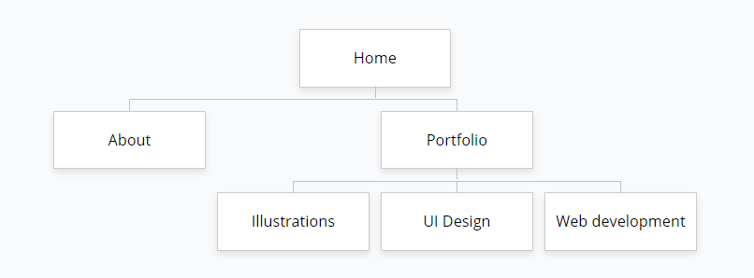
Navability

Slide 5
Visual hierarchy
The content needs to be layed out in level of importance.
The page will have a navigation bar at the very top because navigation through the website is very important.
There is a main section with a title and background image. The title and heading of the page is important because it lets the user now where they are in the site.
The pattern then continues down the page of the website.

Slide 6
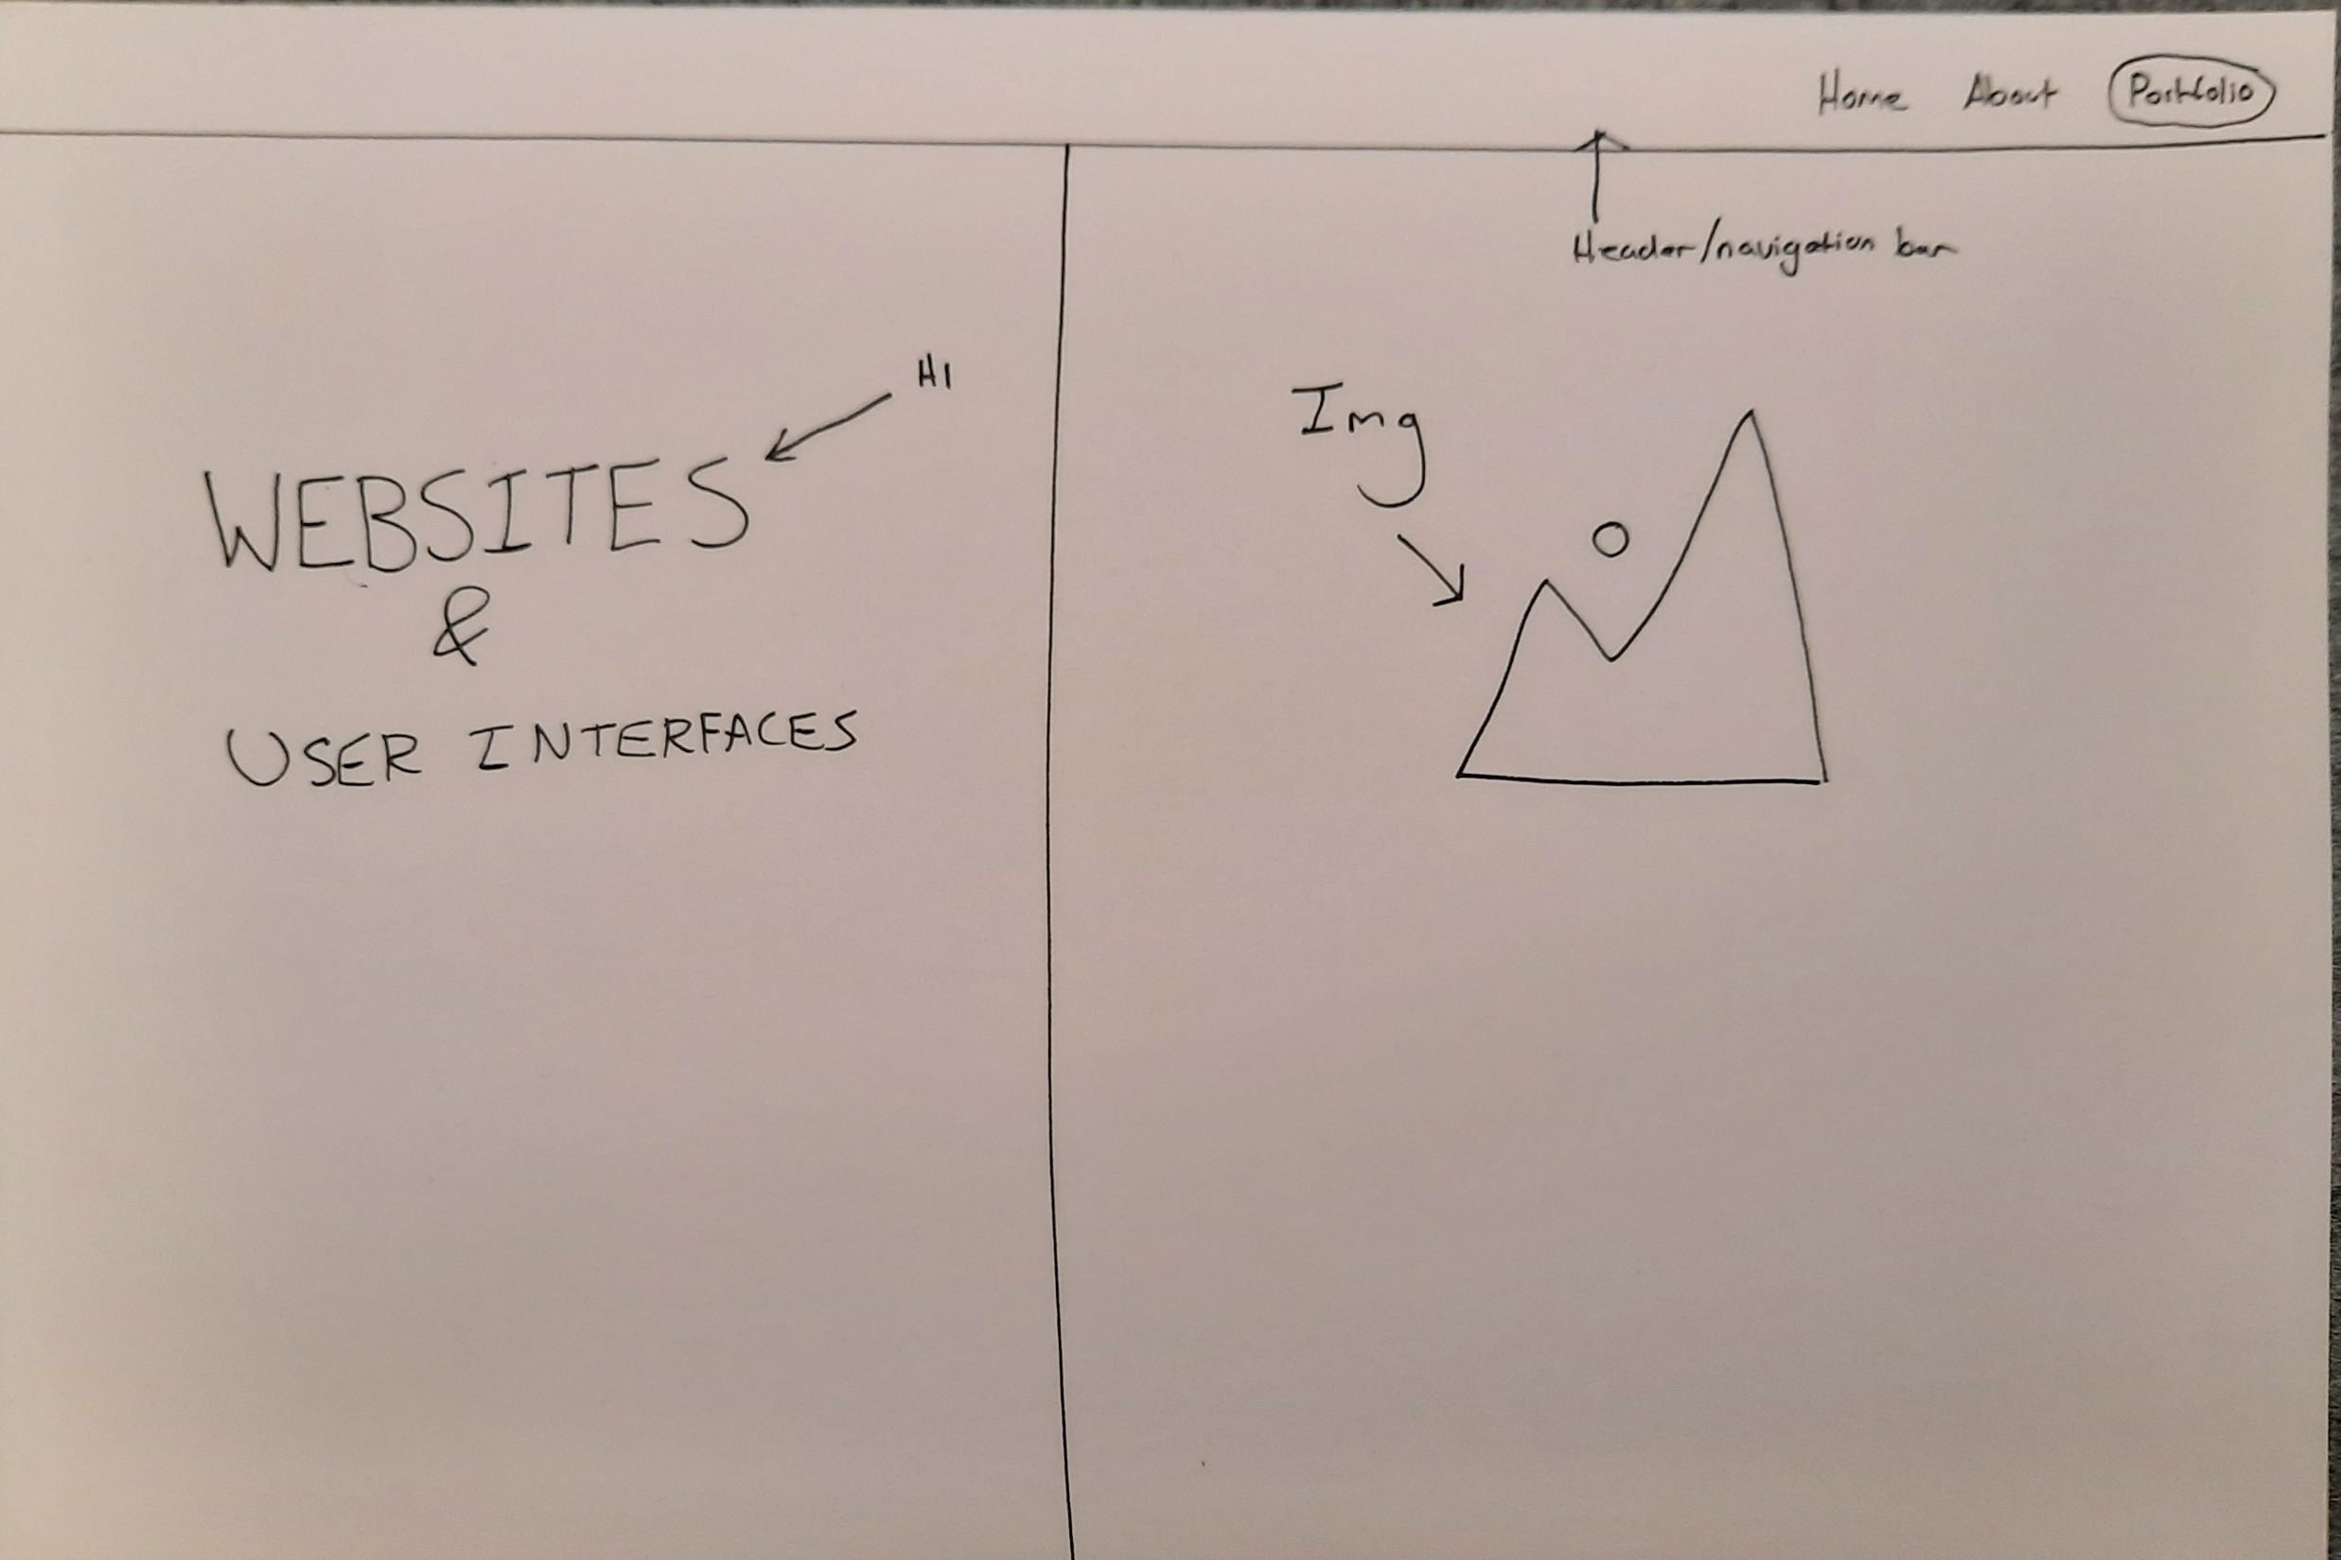
Home page
H1 and H2 title/heading
Image
This is the homepage, the initial mock-up showed the layout of the homepage. I was thinking of having two dividers(div) to sperate the text and have a feature image

Slide 7
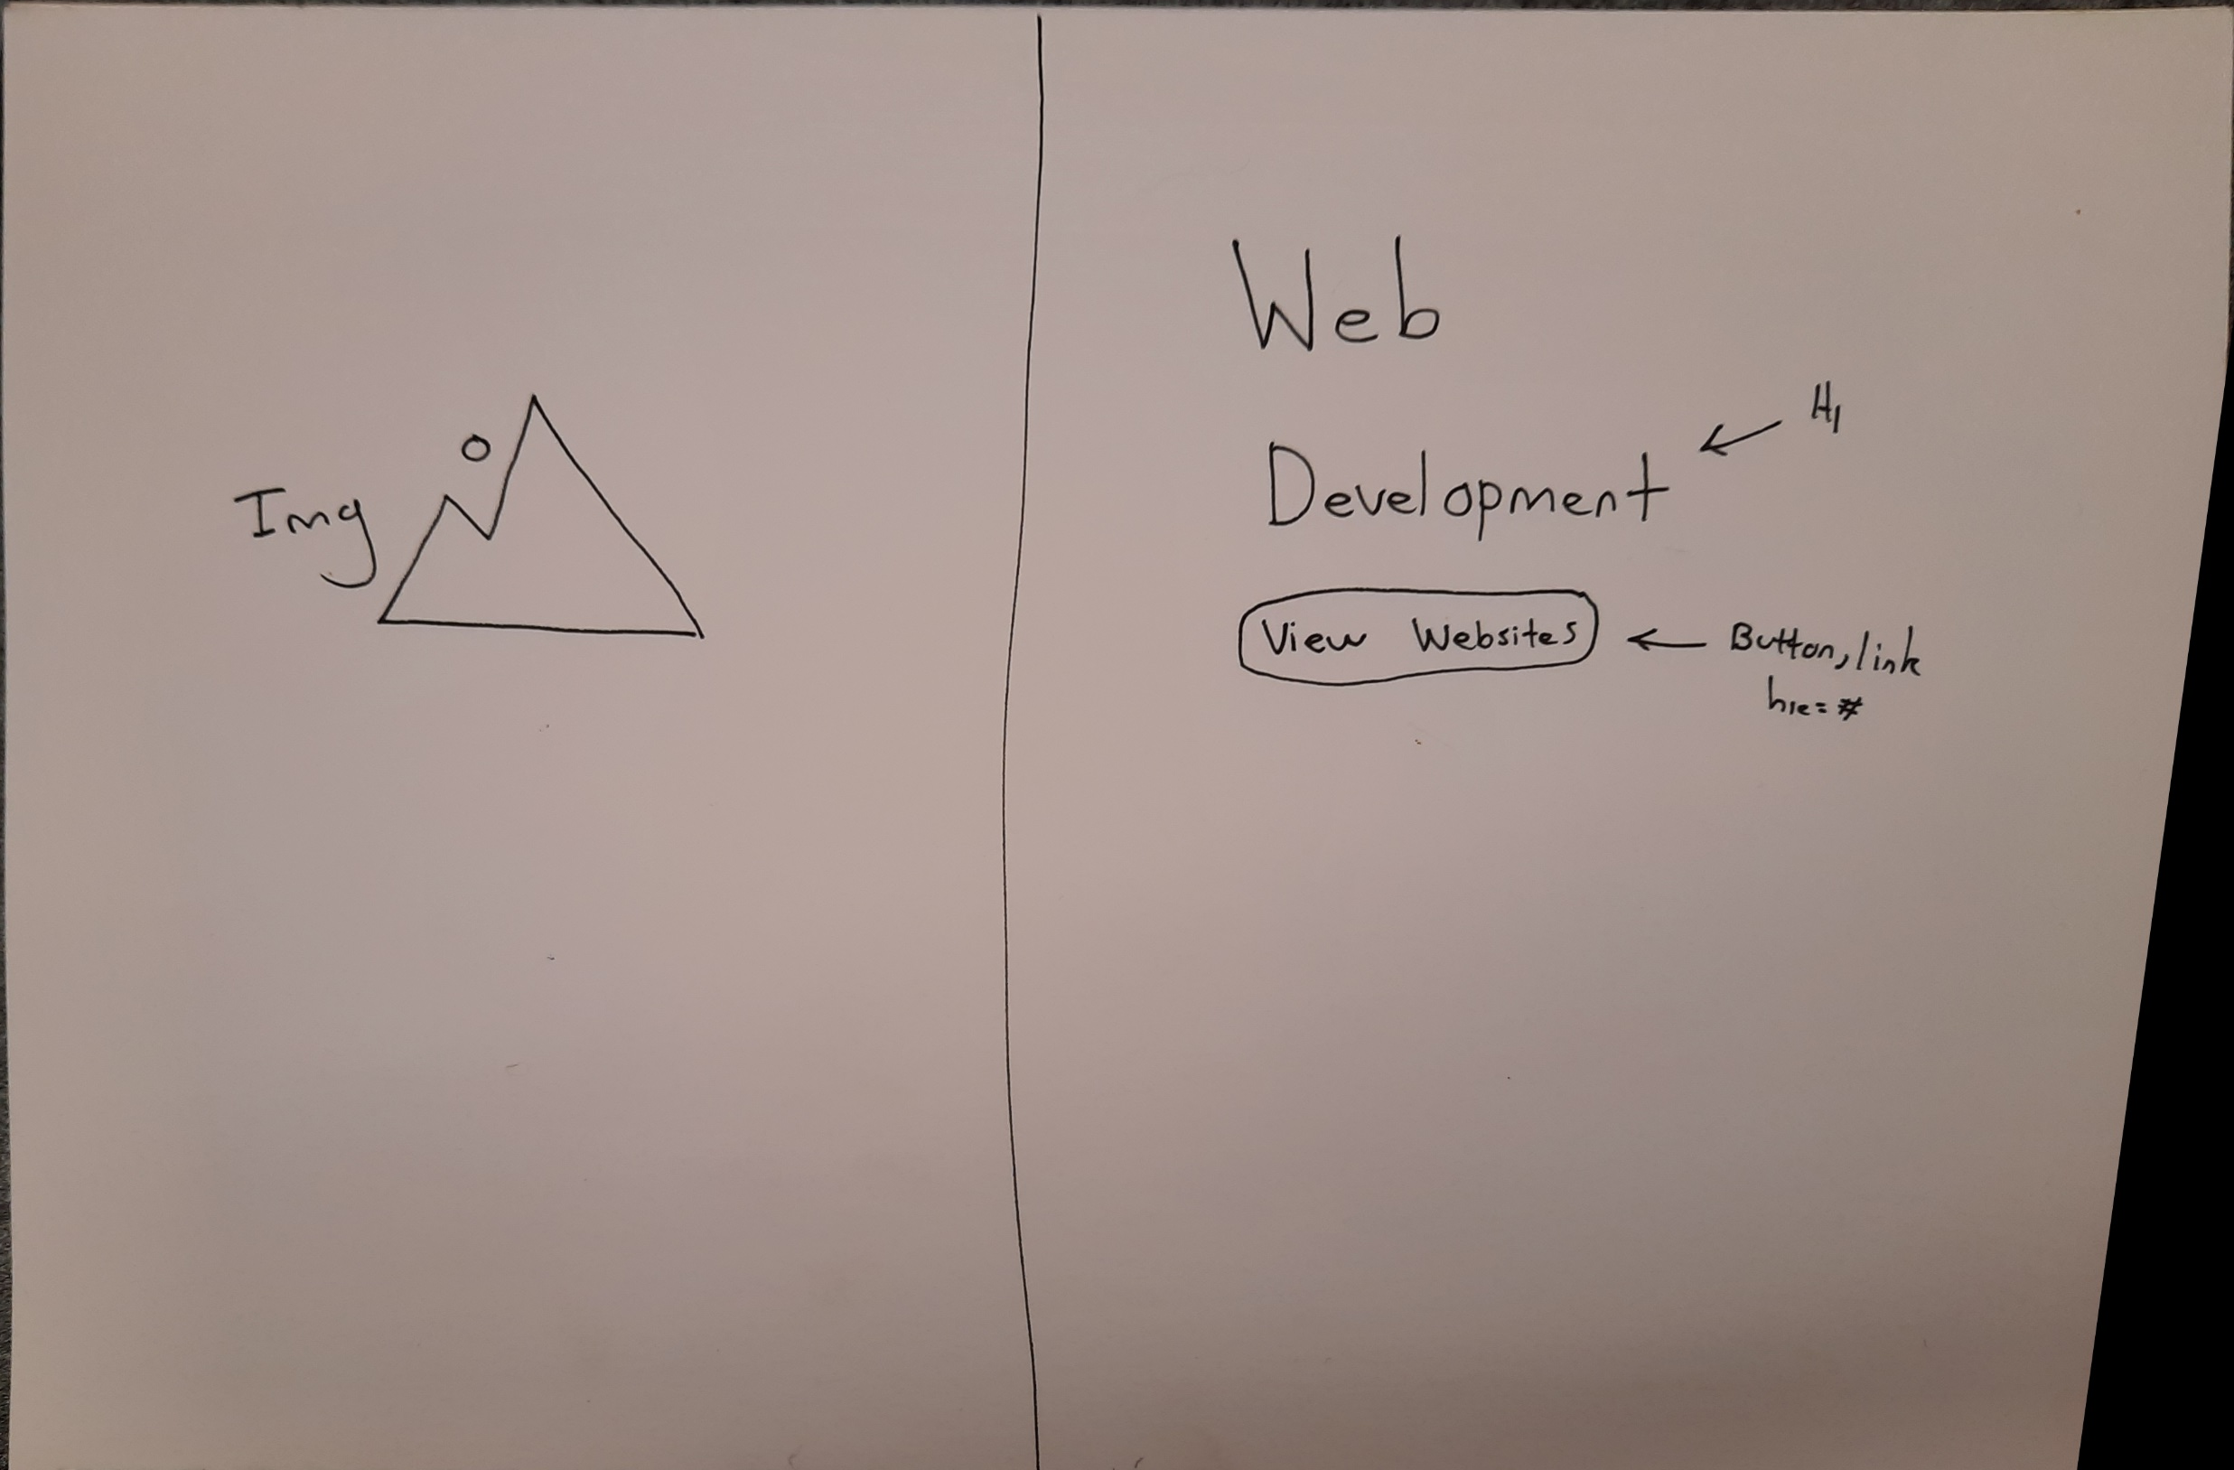
This is the second part of the home page when the user scrolls down. There is a similar layout to the landing/main section
There is a call to action button taking the user to web development page

Slide 8
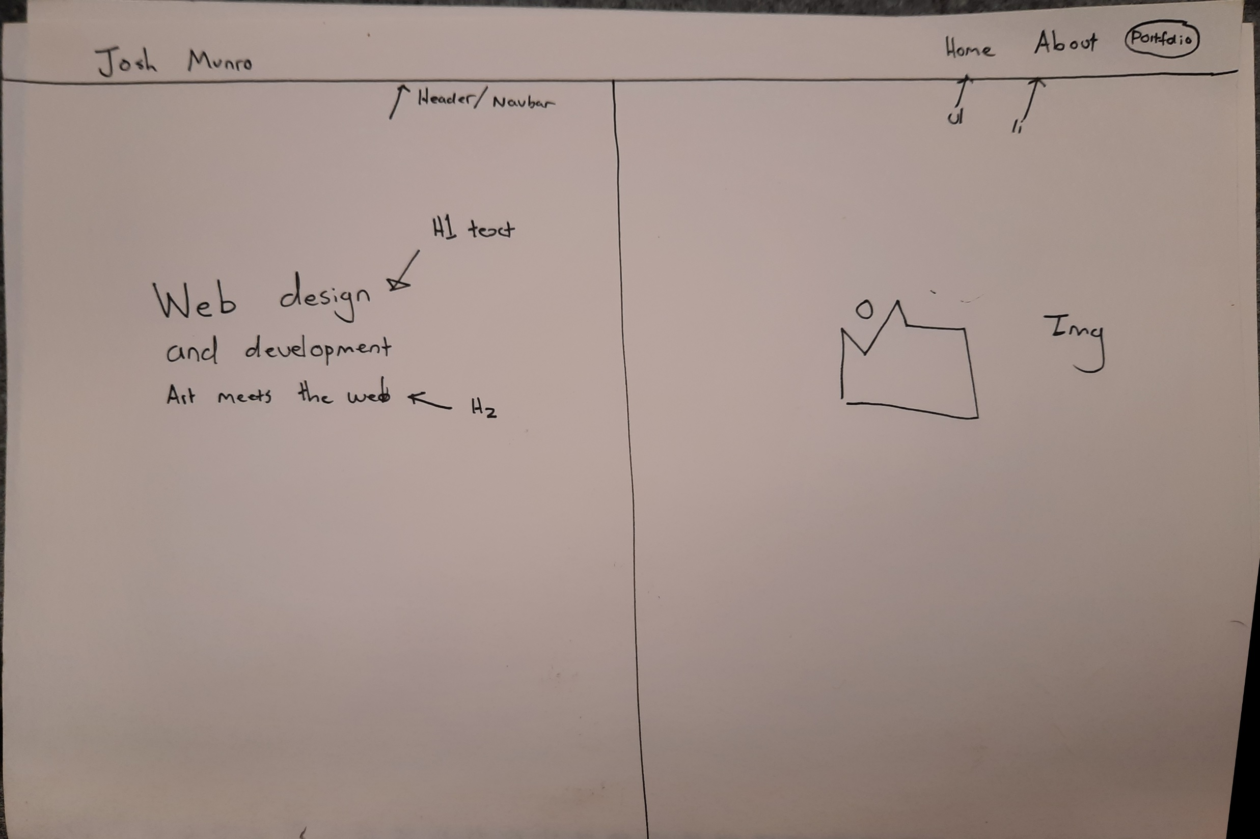

Slide 9
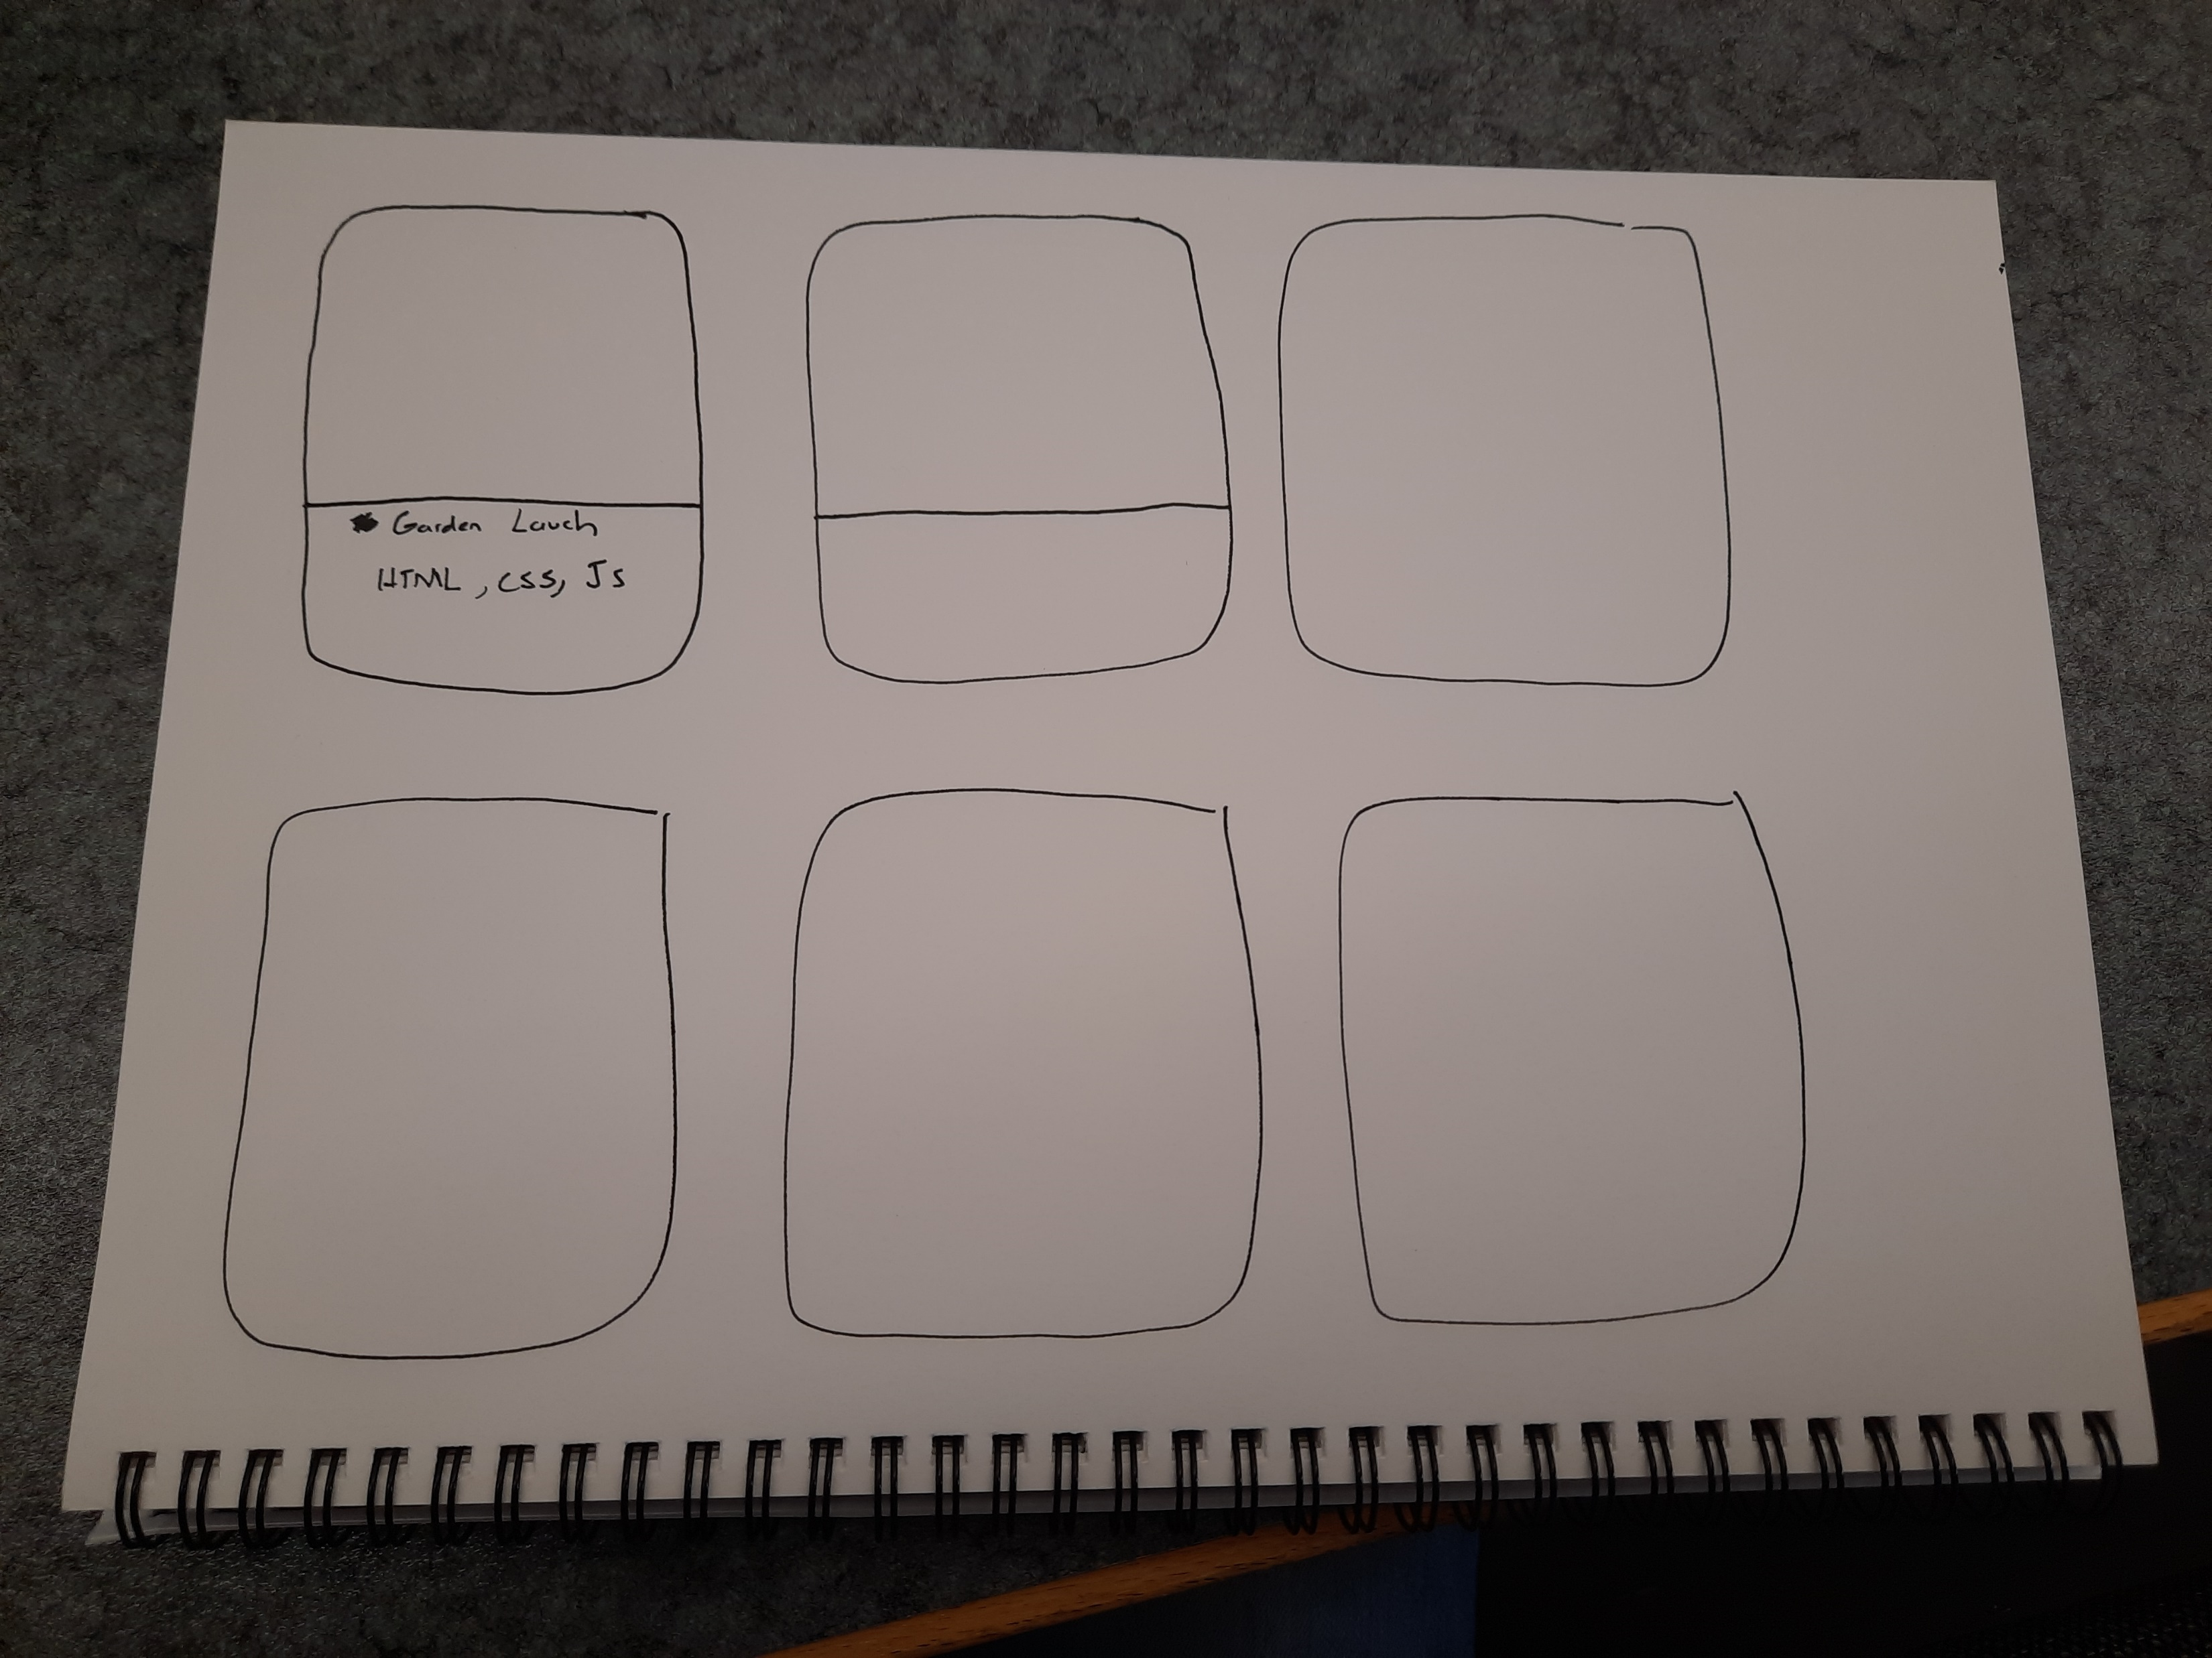
This is a basic layout to how my content will be displayed. I was thinking of having my content gridded into cards.

Slide 10
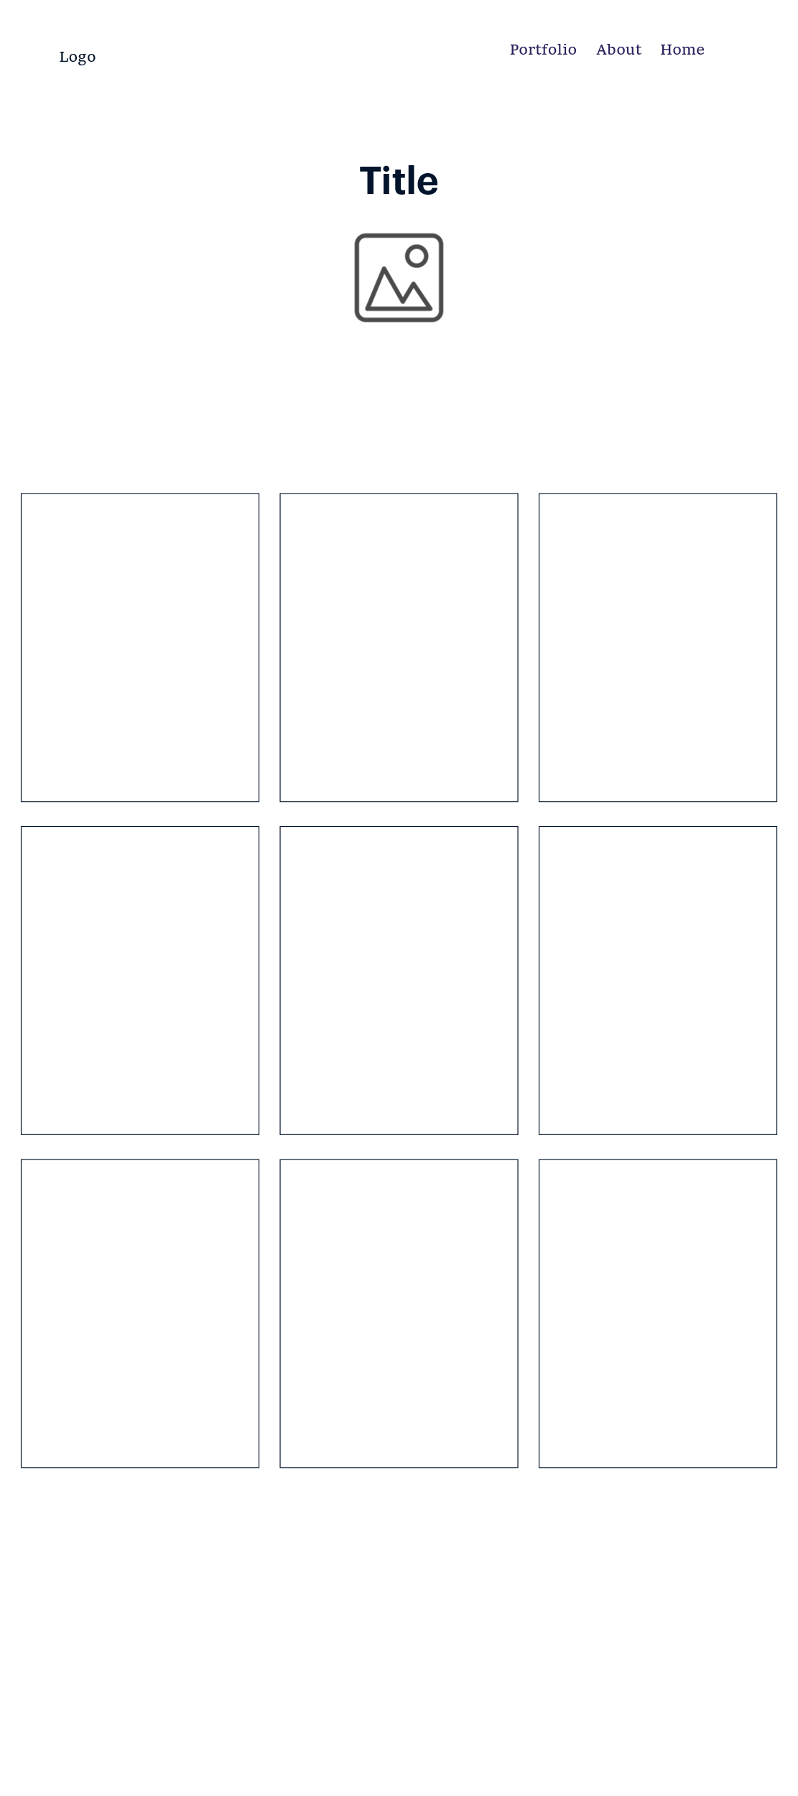

Slide 11
Mockups using Adobe XD

Slide 12
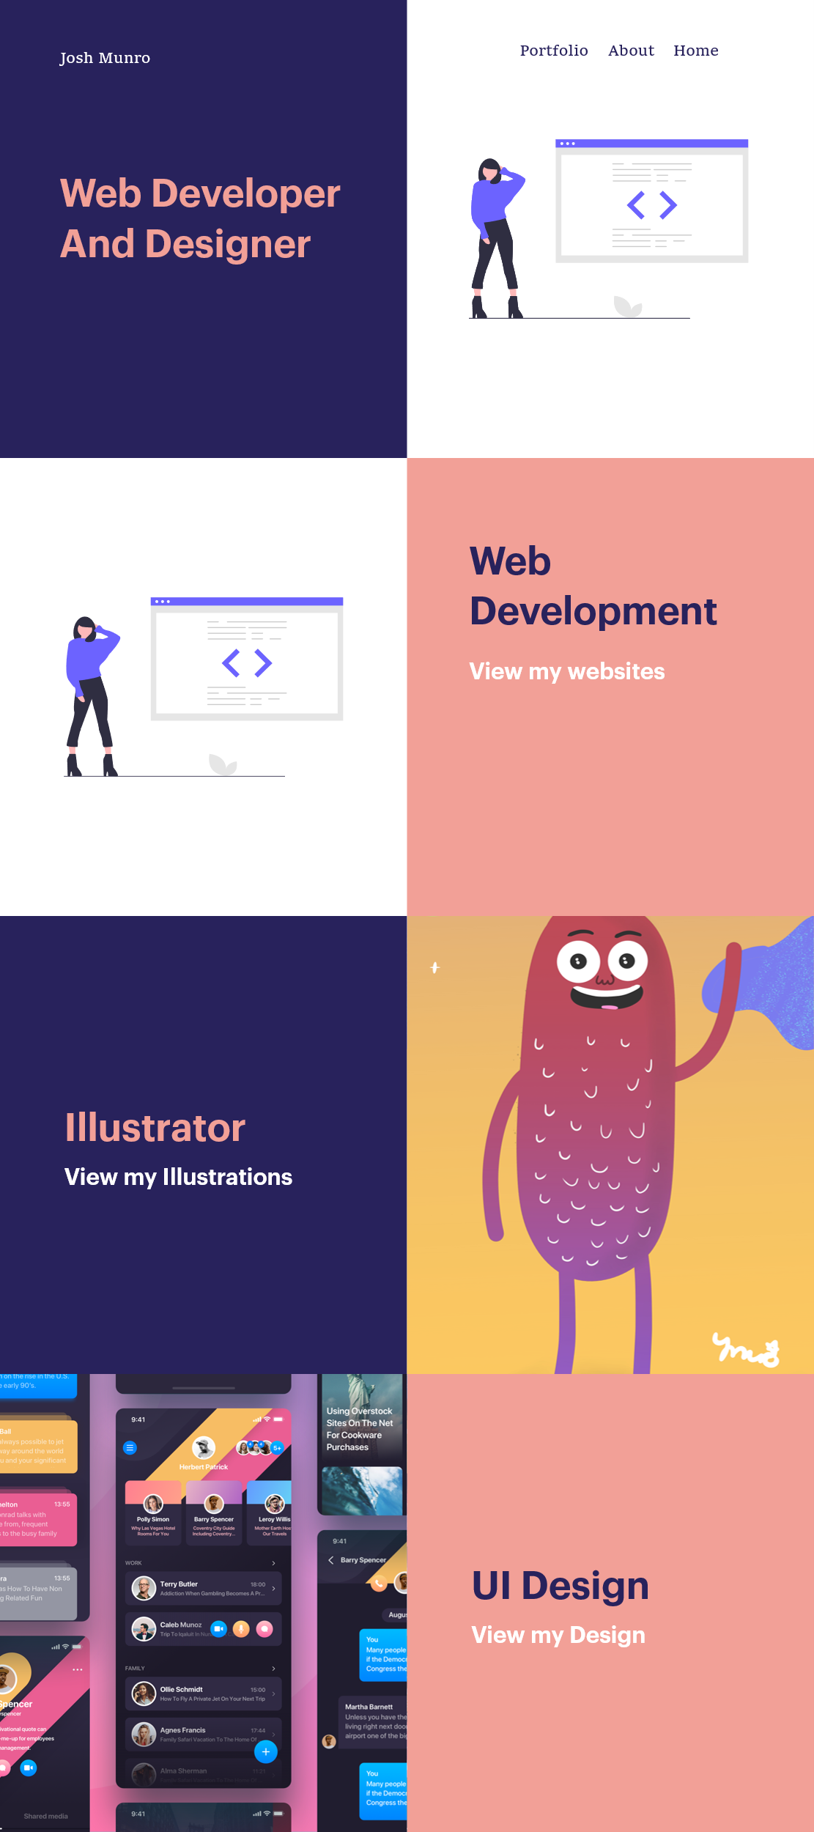
Navigation bar
Here is the main landing page with a image on the side and text on the other side
Illustrator section
UI design section

Slide 13
Process one
When creating the initial design of the website, I had to confine what my website needed to represent, and how I would show that through colours shapes and layout of the website.
I explored many different ways of layout design and colors that are captivating and tell the audience the style of my own web design and illustrations.

Slide 14
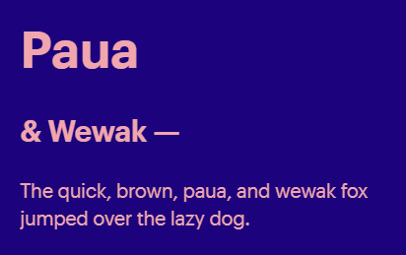
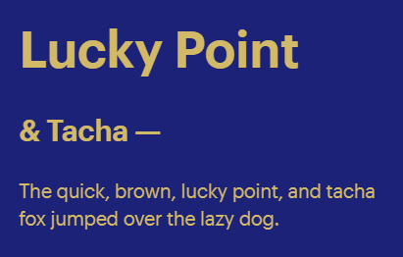
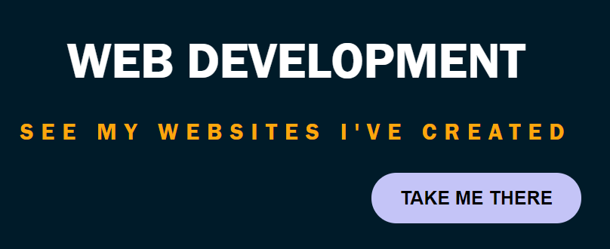
Colours and themes
To select the colours of my website I will use the website Khroma.
This tool chooses colours you like and creates a good contrast of colours that go well together.

Slide 15
Colour process
In the design phase I explored different colours the three images from the previous slide showed the different simple colour palletes I explored. I wanted my website to showcase contrasting colours that would make the illustrations, font and content stand out from the background.

Slide 16
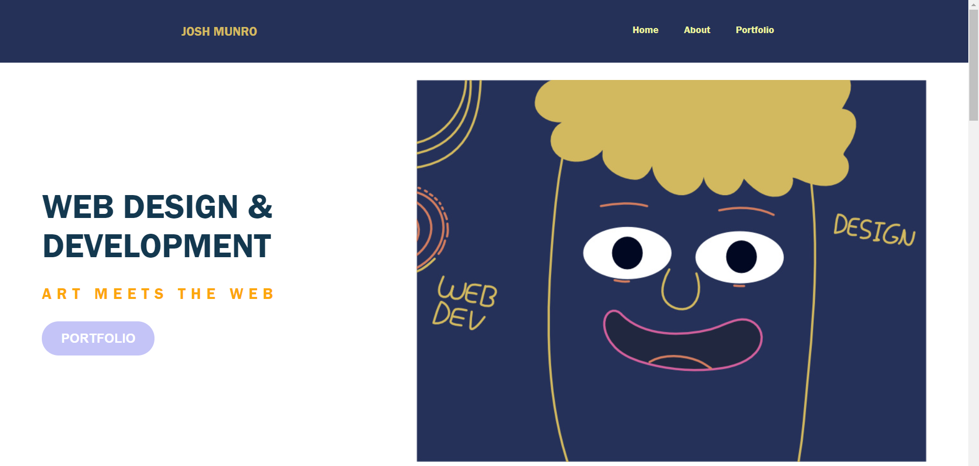
Layout design

Slide 17
Evaluation of website design
I liked how the main section has two columns that separates the title and illustration. However, I would like to explore the possibility of having a background image with text Infront as another design choice.

Slide 18
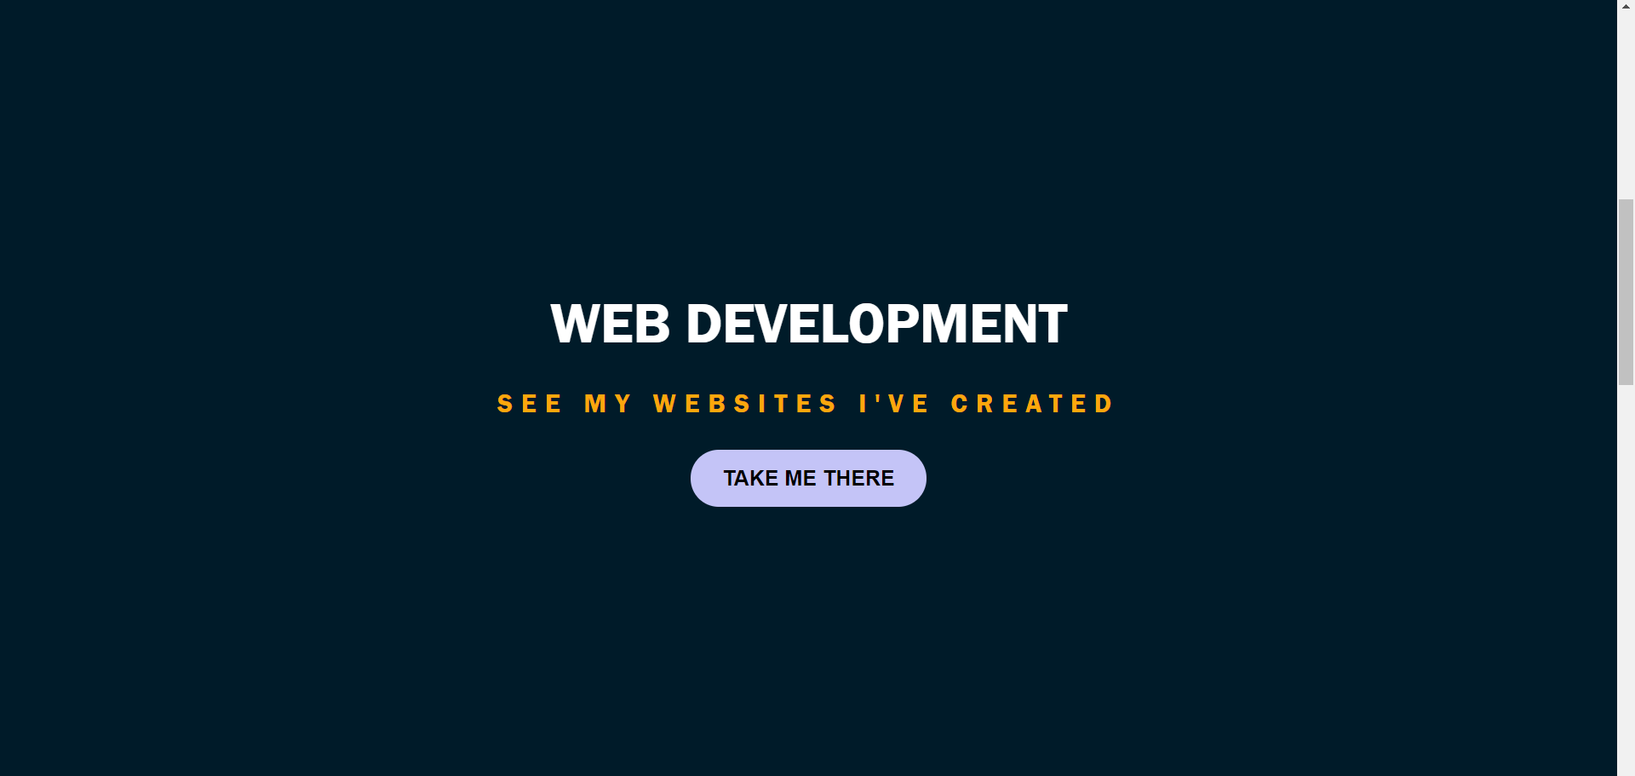

Slide 19
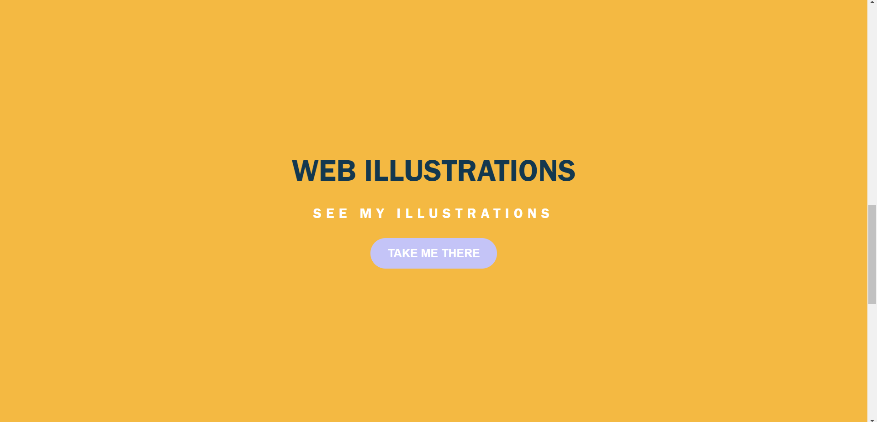

Slide 20
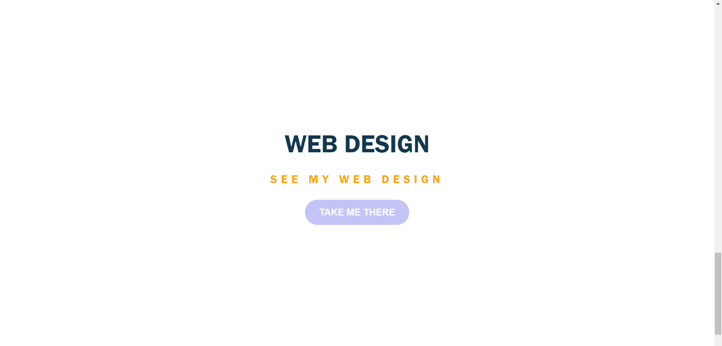

Slide 21
Evaluation of design part 1
In the initial design phase I went ahead and created the basic building blocks of my website home page design based on the wireframes I had created. I find that coding a design in the earlier phase helps me to better visualise the design of the website as I am confined by the limitations of html and css so the scope of the design will be reliable and understandable on my perspective.
I liked the design of the contrasting background and h1 and h2 text that created excitement and jumped at the audience. However, I thought that the design was too simple and had too much padding and space. There I thought that I could add a divider with a image on one side of the section.

Slide 22
Layout and design
There will be a main landing page. In that page there will be two dividers, one will have a background colour and a title.
The other half will have a illustration using similar colours and themes of the website.

Slide 23
Main section design

Slide 24
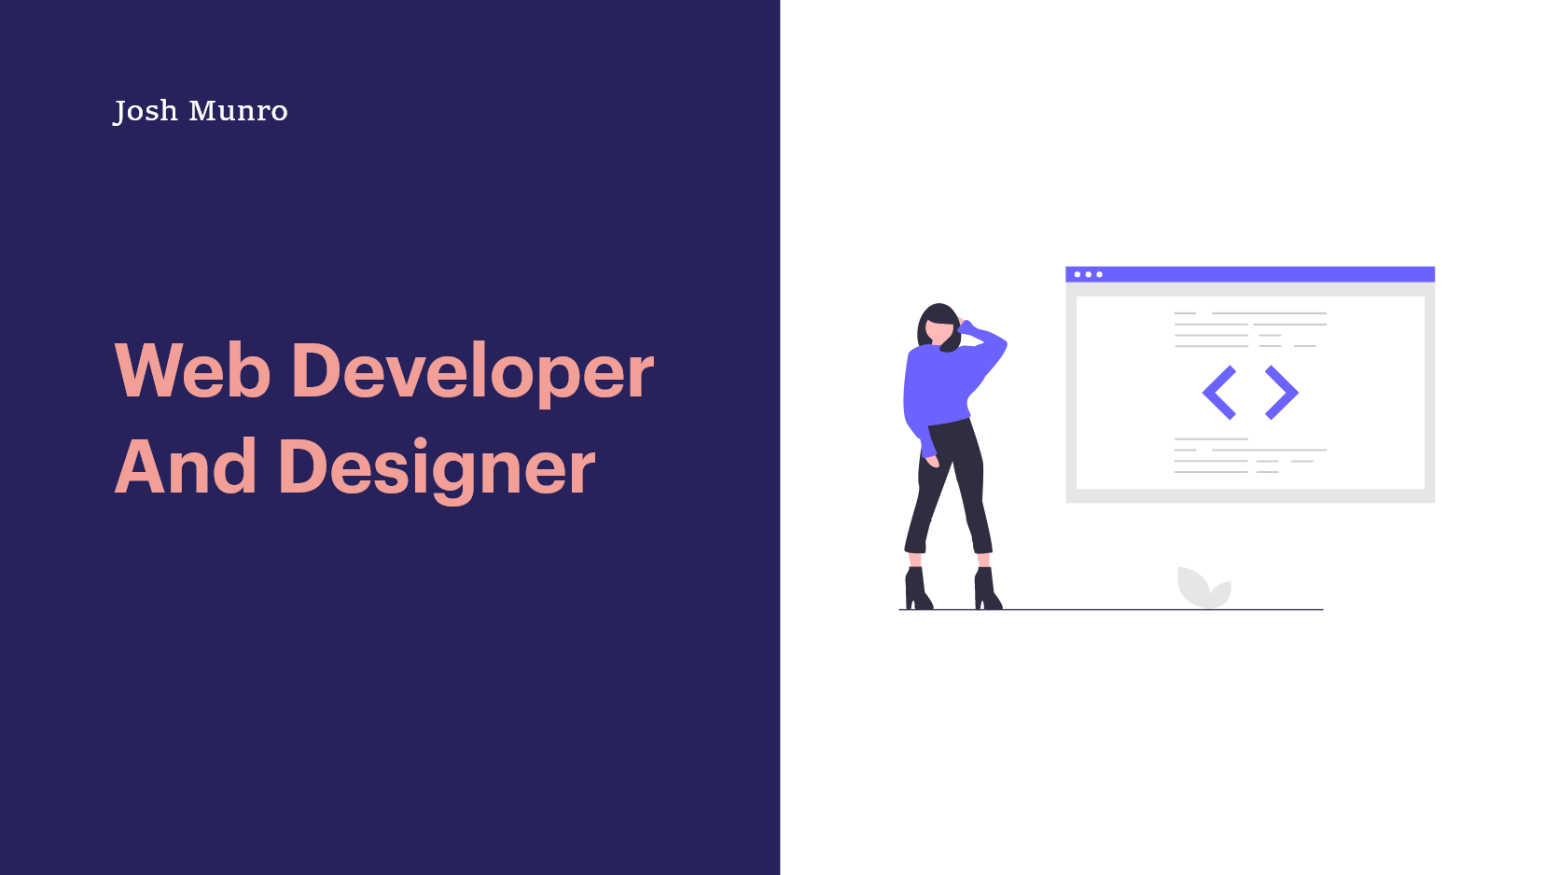

Slide 25
Discussion of design
I needed a landing page that would pop and stand out as my portfolio was heavily focused on web design and illustration. I really liked the constrasting and darker colours for the landing page. The image on the right brought balance to the design, but also was captivating and interesting for the viewers.

Slide 26
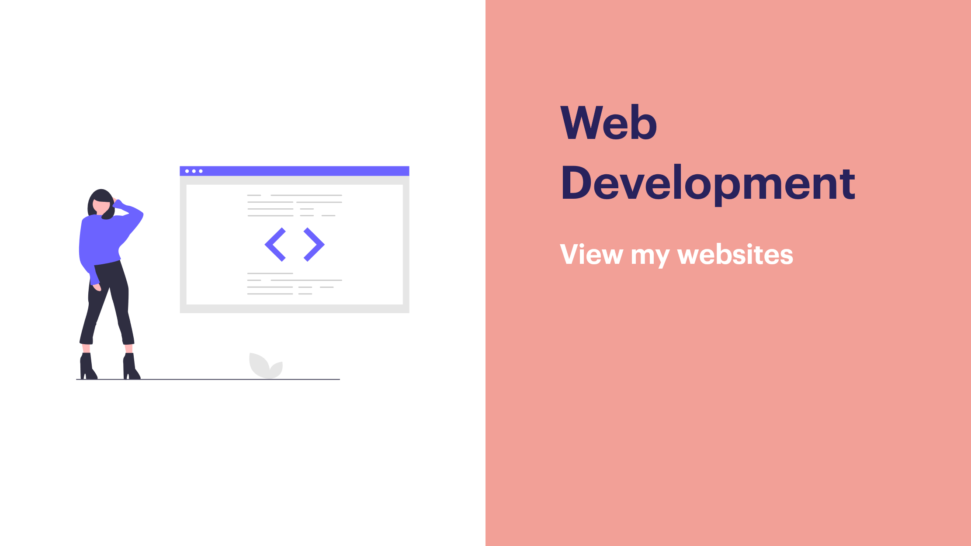

Slide 27
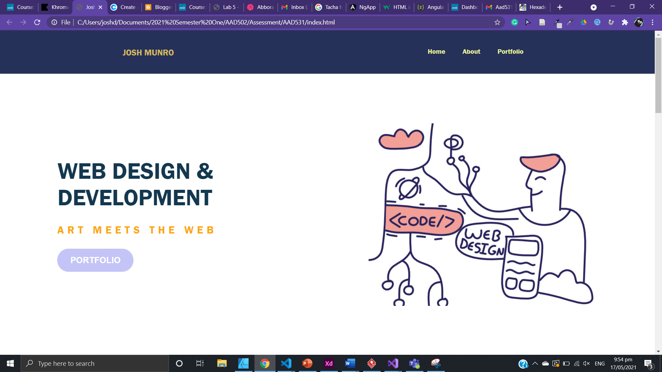
This is interesting design, but it wasn’t want I envisioned.

Slide 28
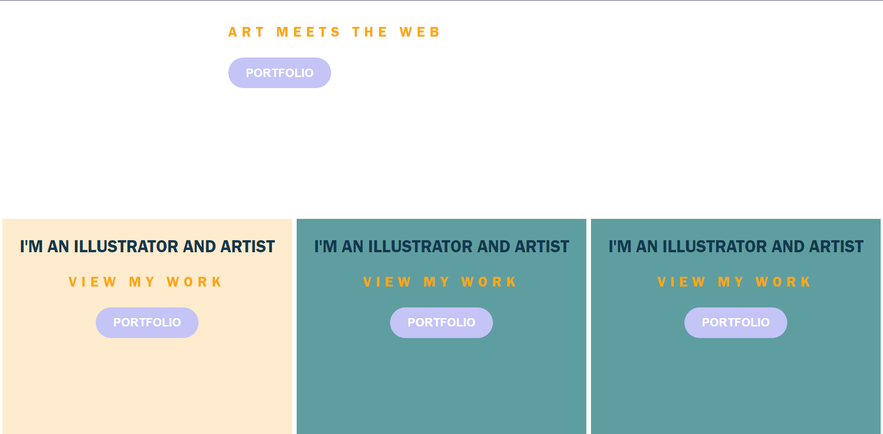
I tried doing something different and decided to the section into three boxes
The new design has removed unnecessary scrolling and white space

Slide 29
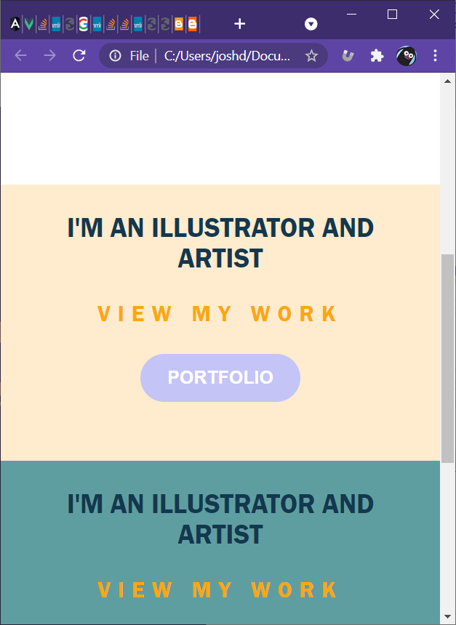
The containers/cards were also responsive using flexbox flex direction as column.

Slide 30
Testing the responsiveness of the website.
The website needs to be responsive therefore, early in the development of the website I had to make sure what the website would look like from a mobile and tablet perspective. I used flex box and set the flex-direction to column with the media query. This made the containers and divs stack up on top of each other. Which was beneficial for viewing the information on a smaller device.

Slide 31
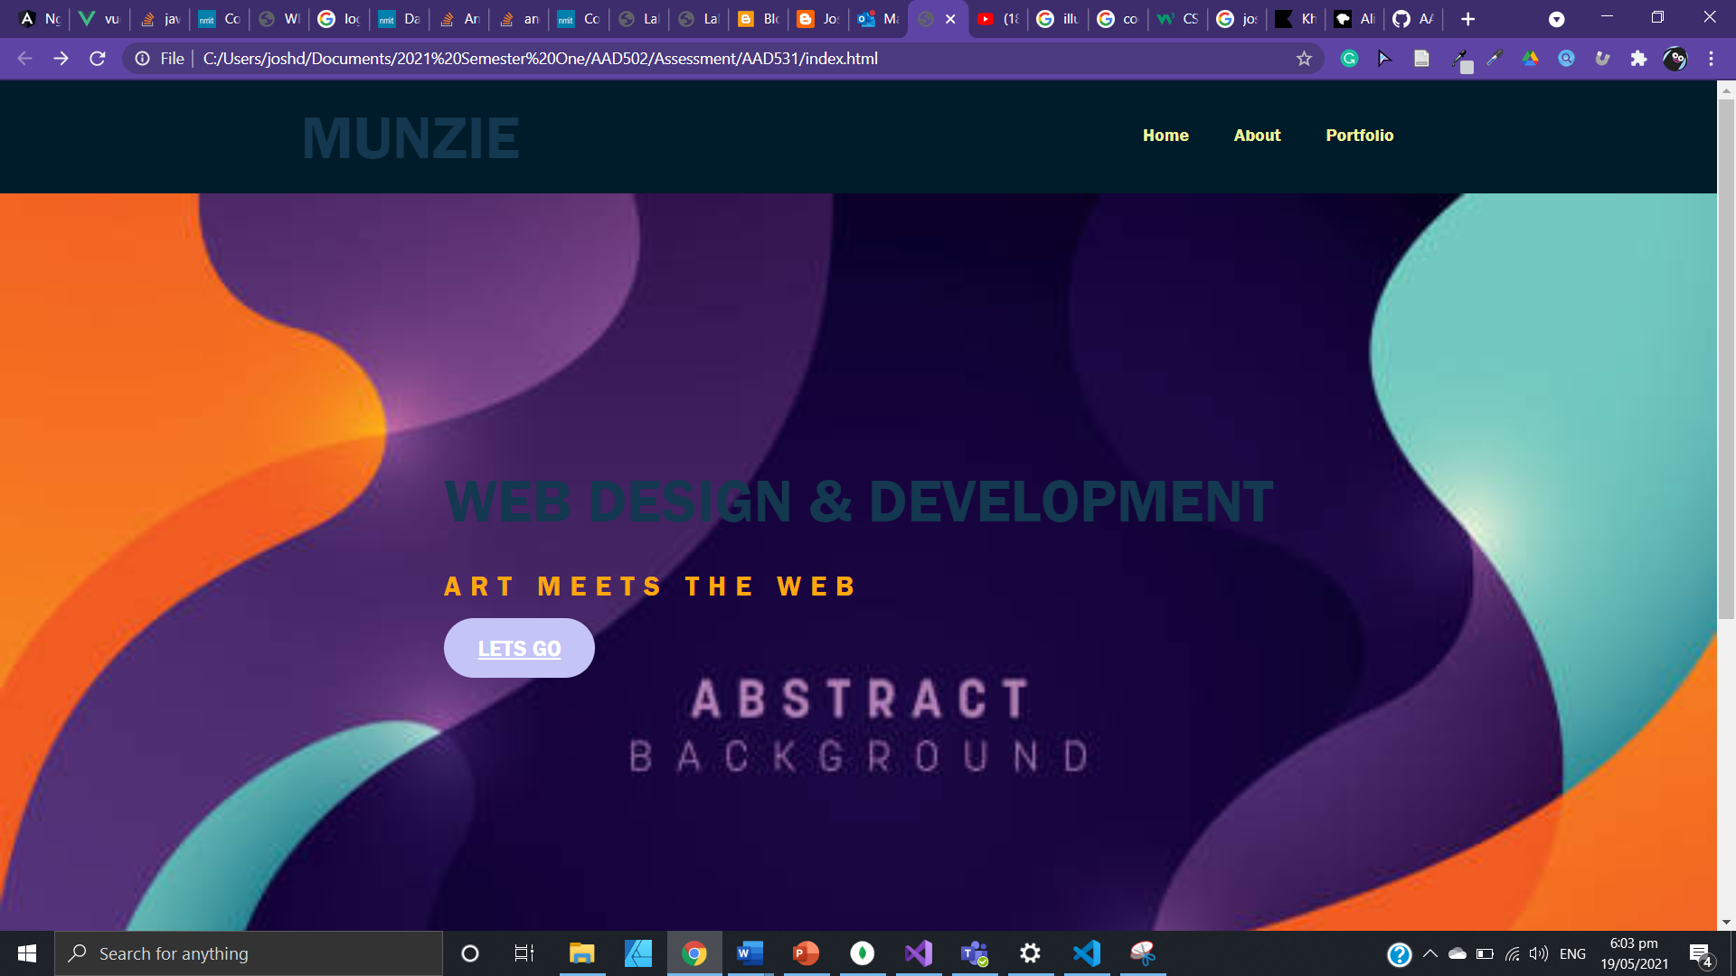

Slide 32
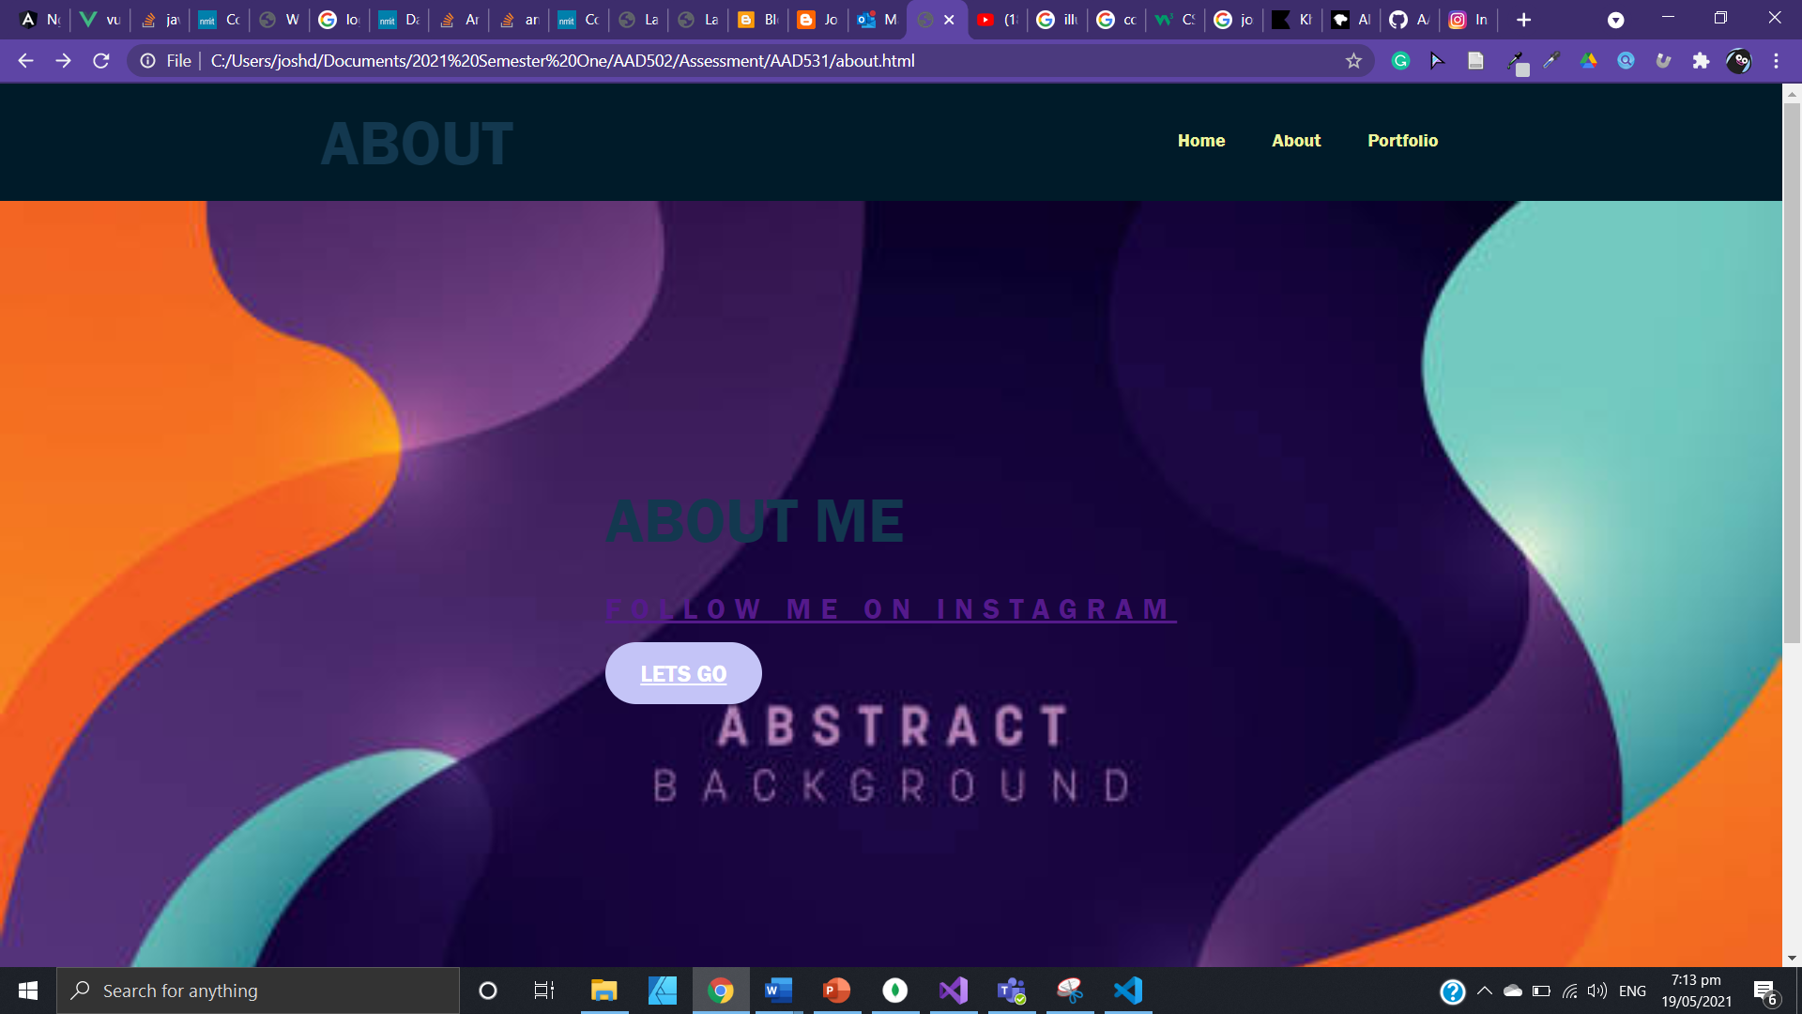

Slide 33
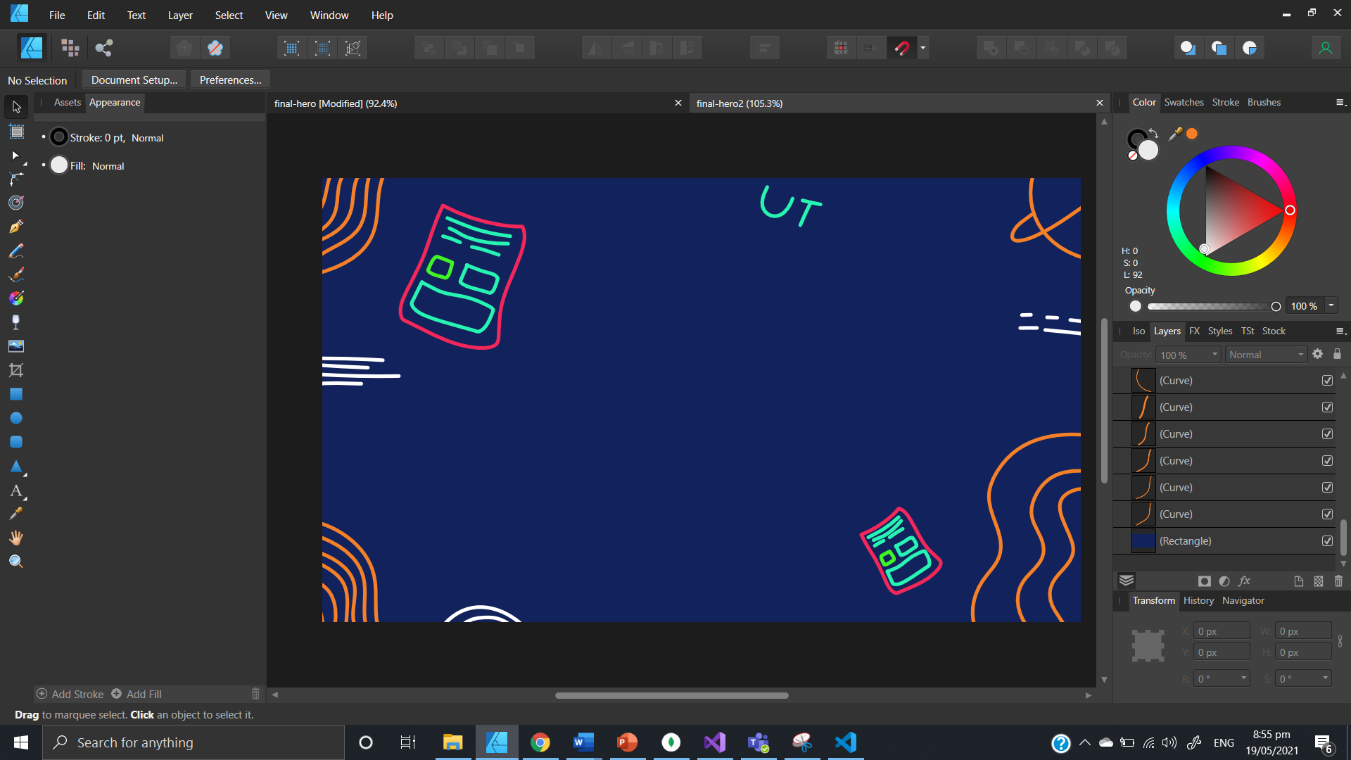

Slide 34
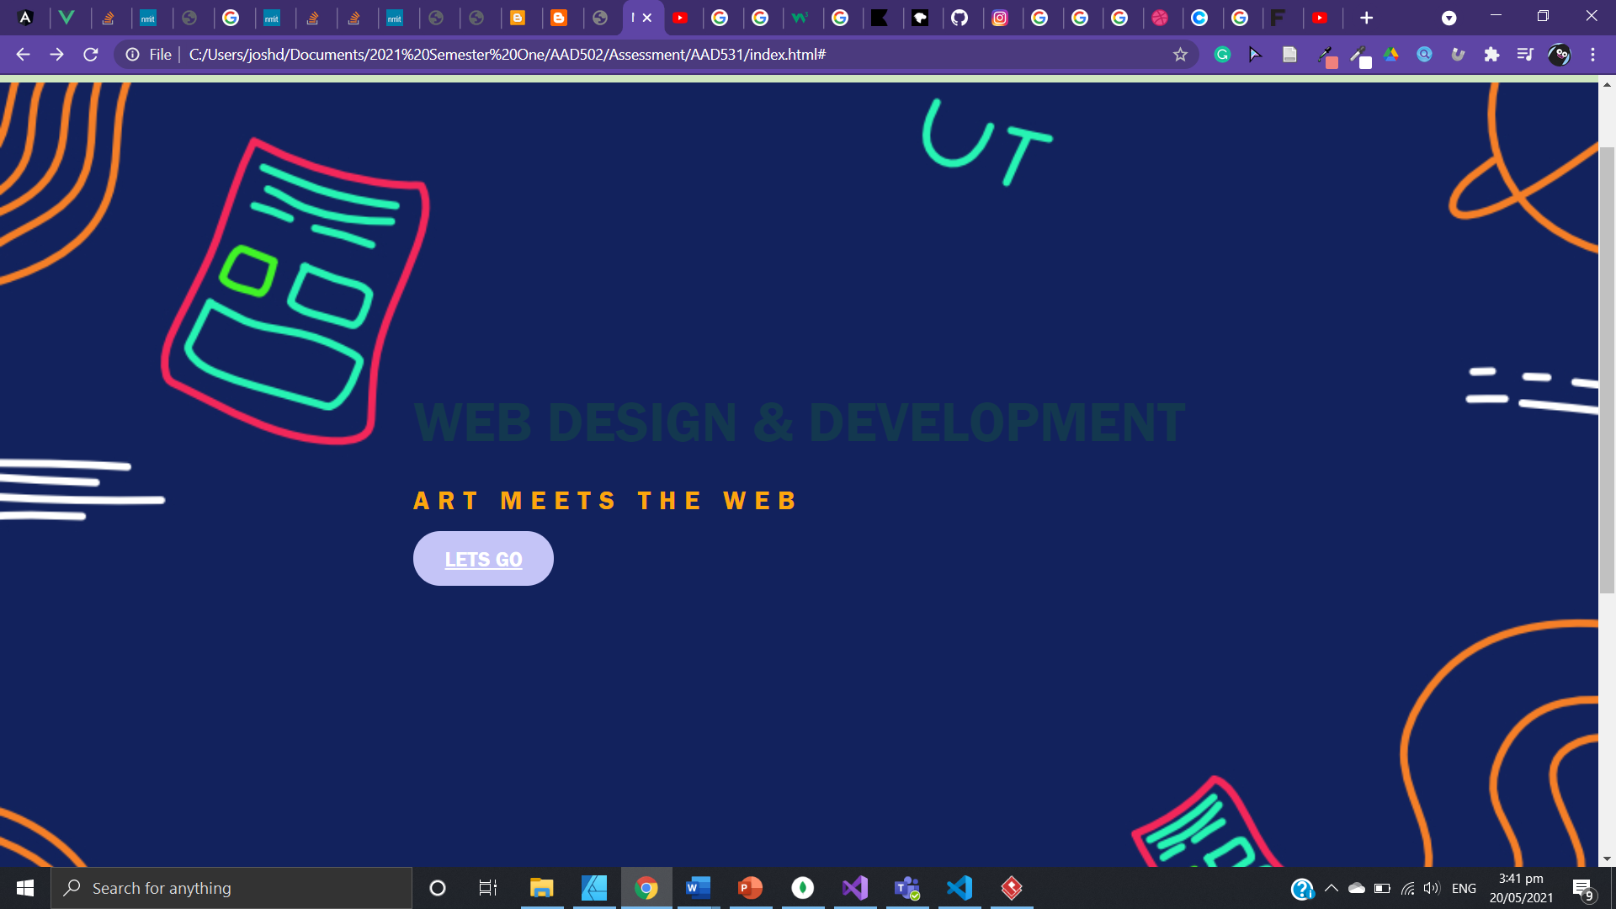

Slide 35
Evaluation of design
I explored using affinity designer to create an illustration that represents a common theme of design, illustration and development. However, the colours and way the illustration looks as a background-image doesn’t look atheistically pleasing and easy to look at for the viewers. The image resolution also looked poor and blurry, which doesn’t bring a pleasing UI interaction with the user.

Slide 36
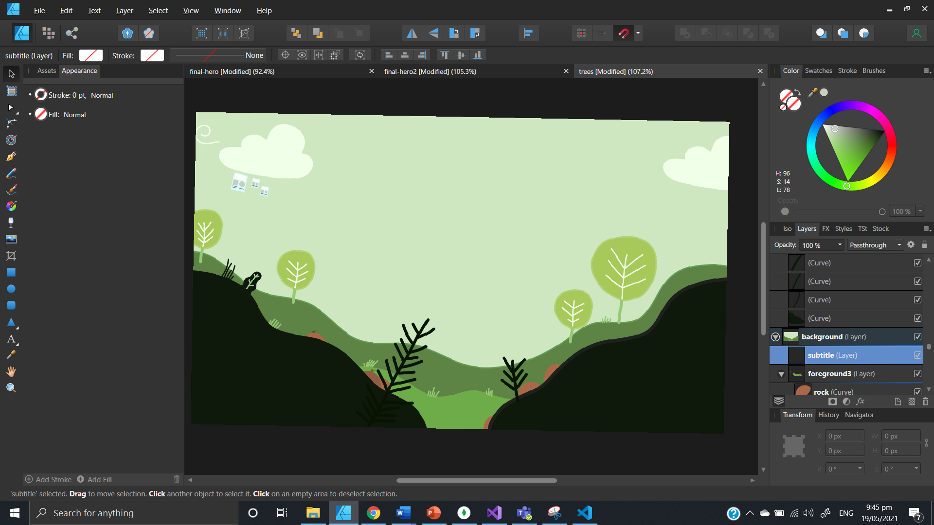

Slide 37
Evaluation of design
I had a change of mindset and decided to explore other areas, I let go of my creativity. I discovered inspiration from dribble with an illustration with a nice green colour palette. I used a similar palette and began creating an illustration of trees and creation. The theme of creation and trees represented growth and creativity. I thought that I could combine this theme with UI and development, to demonstrate how businesses can grow through the use of digital media (websites, web design, web illustration).

Slide 38
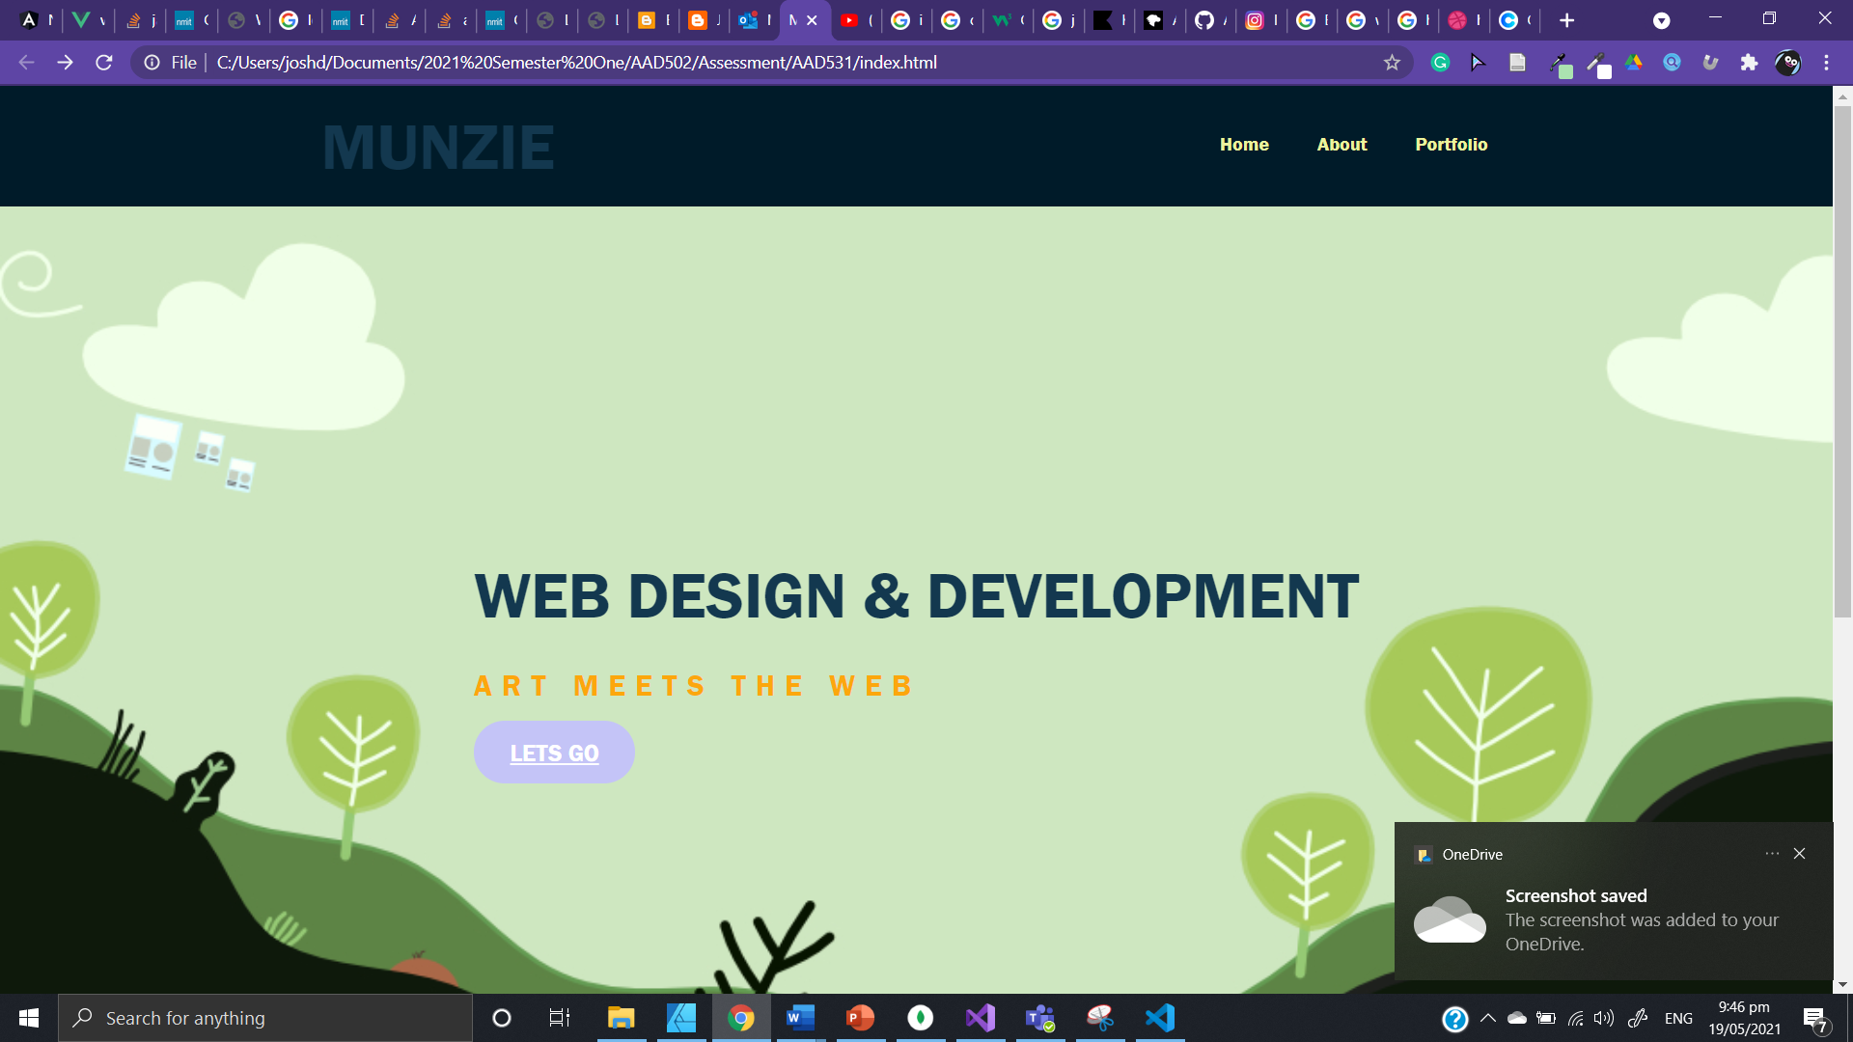

Slide 39
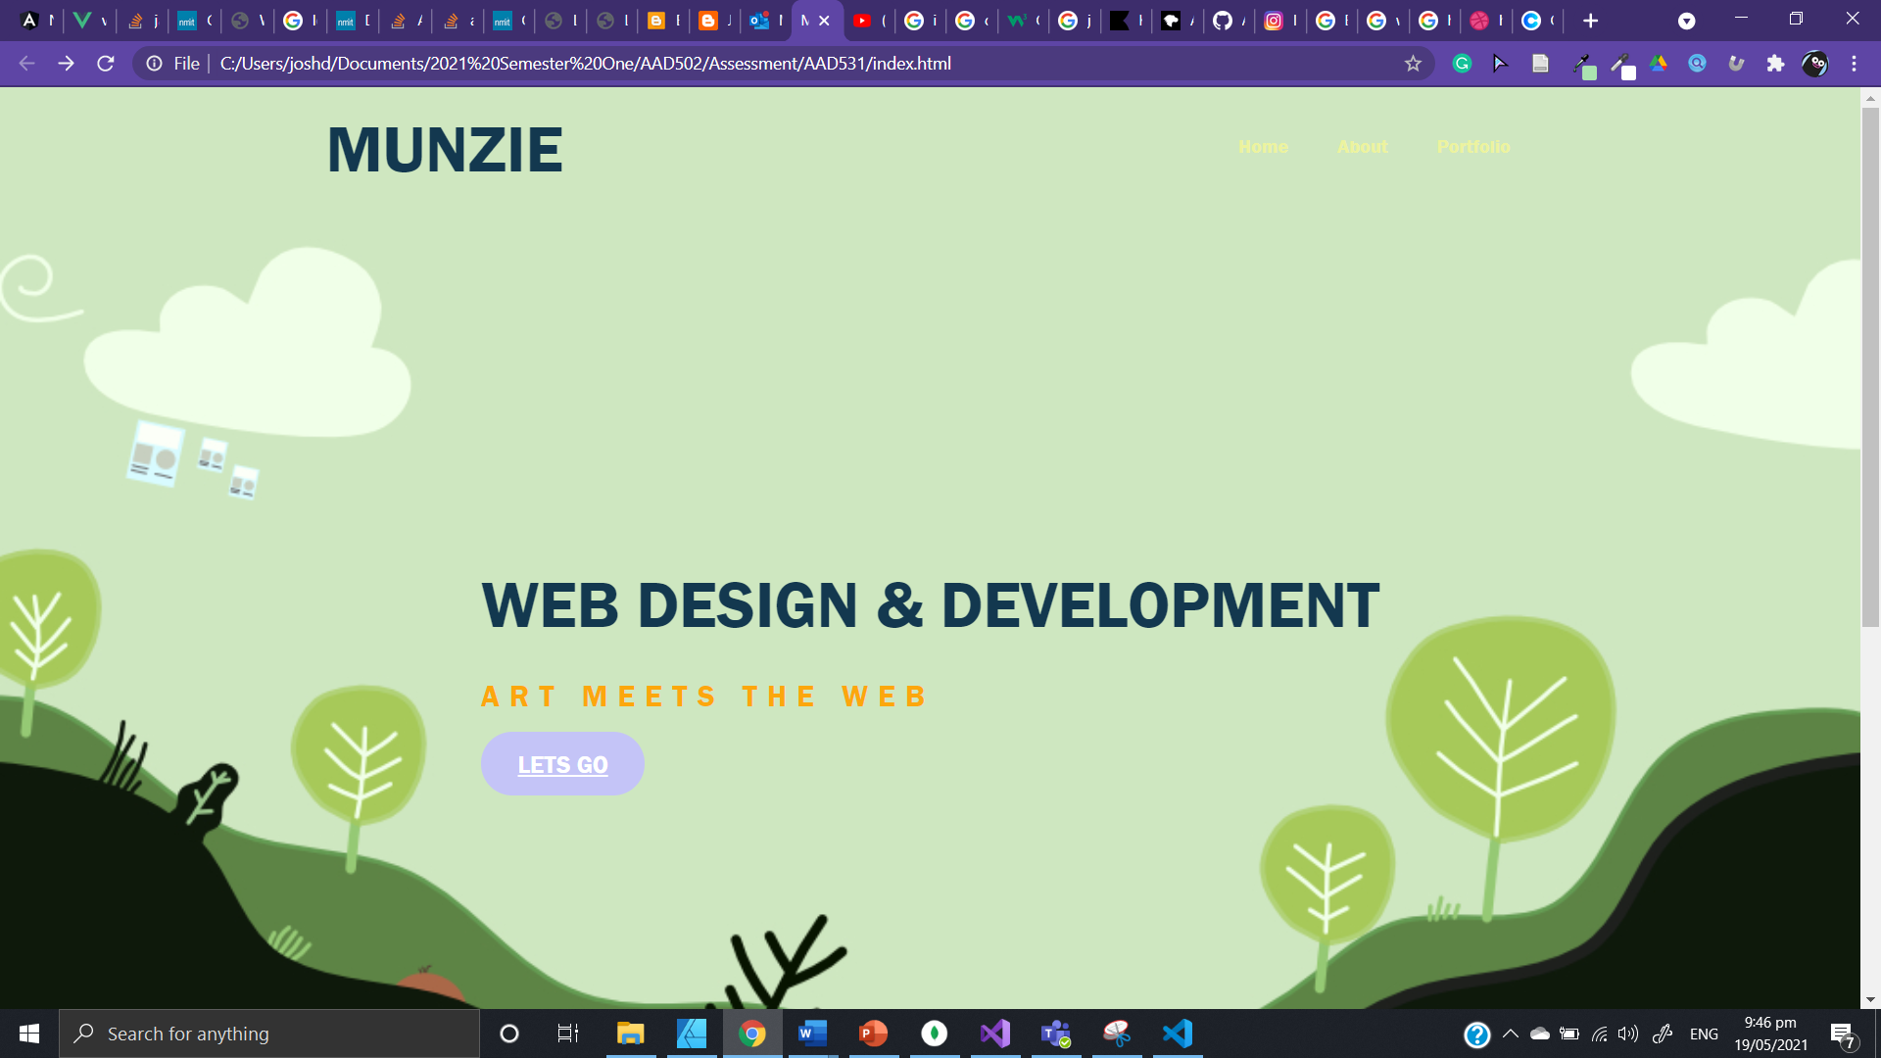

Slide 40
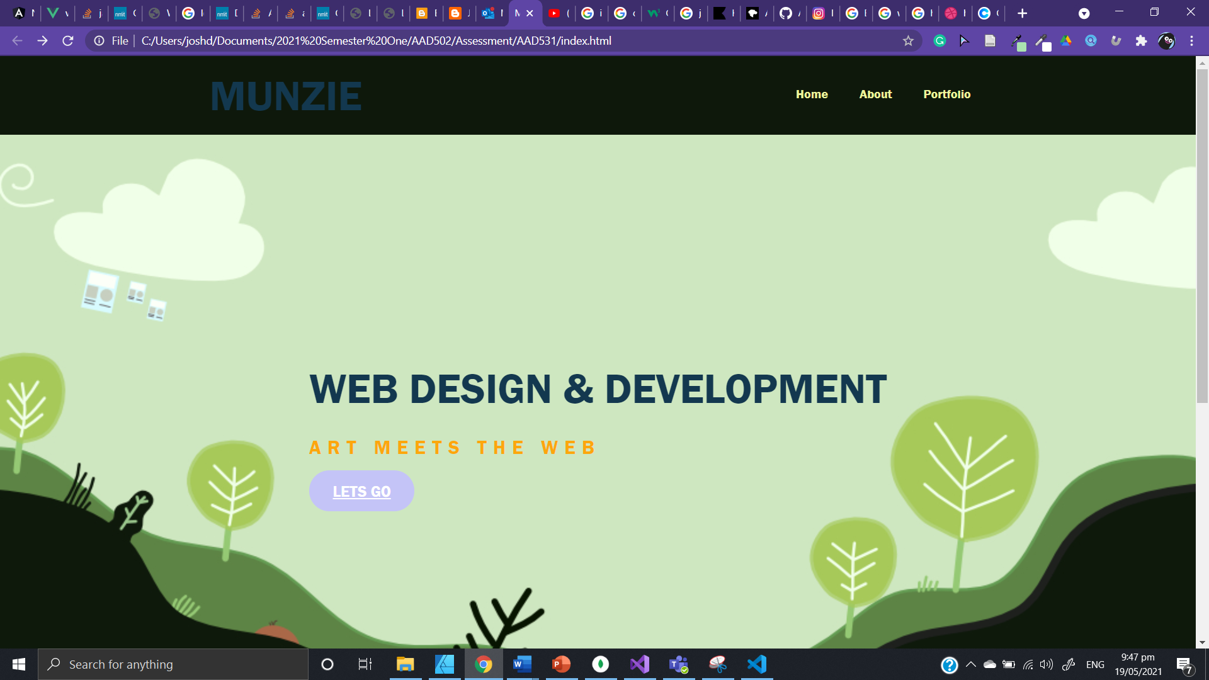

Slide 41
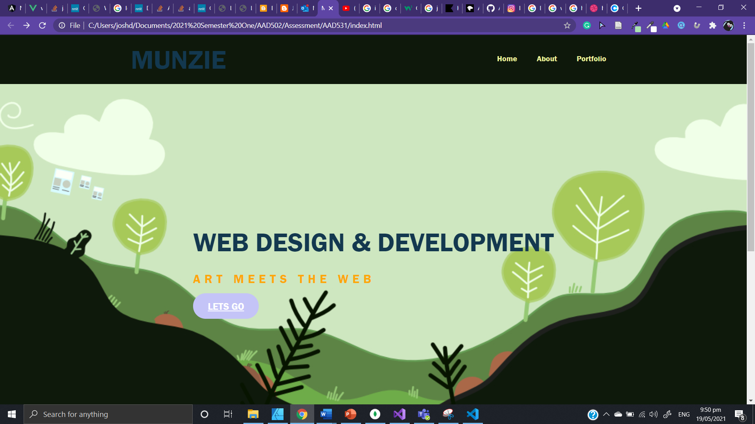

Slide 42
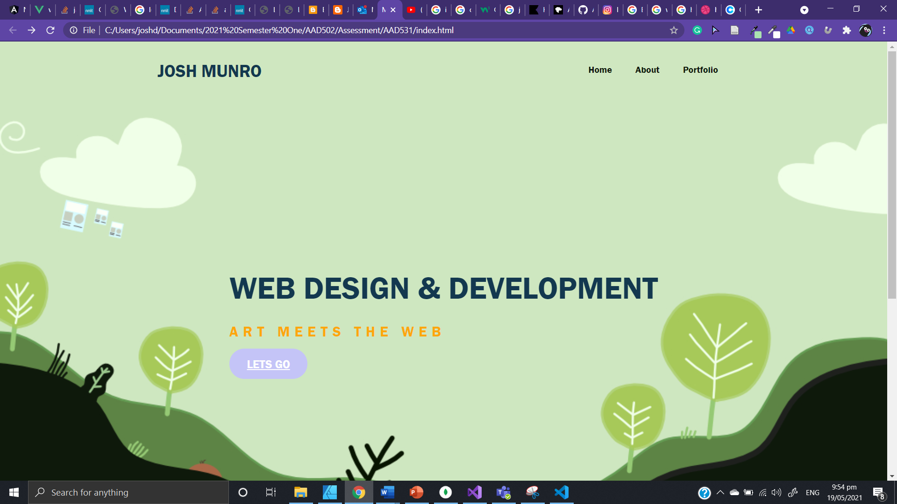

Slide 43
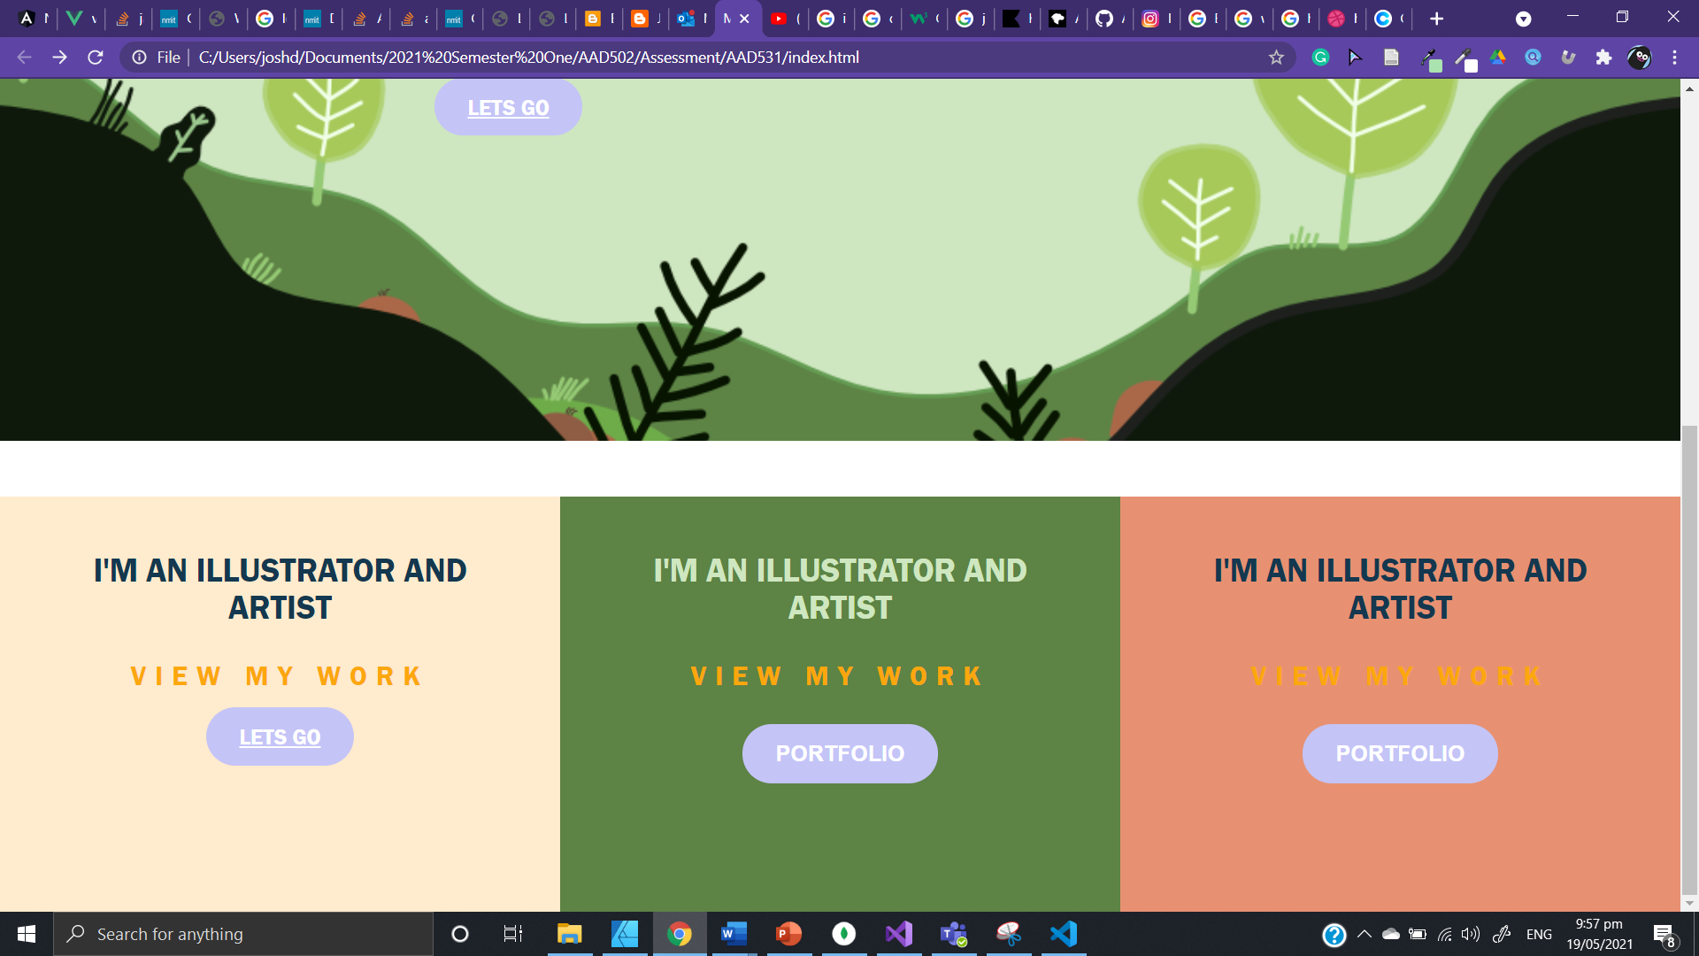

Slide 44
Evaluation of work
The past images show the growth and development of the colour theme and main section of the website. I really liked the colour pallete and contrast of colours from the main section, that I will carry the theme throughout the website.

Slide 45
Tools I have used for the design
Initially I used the classic pencil and paper to create a simple mockup design.
I used adobe XD to build a mock-up of the design.
Adobe XD is a powerful and simple tool for web development. I was able to create simple components and save the themes and colors of the website to speed up the process.

Slide 46
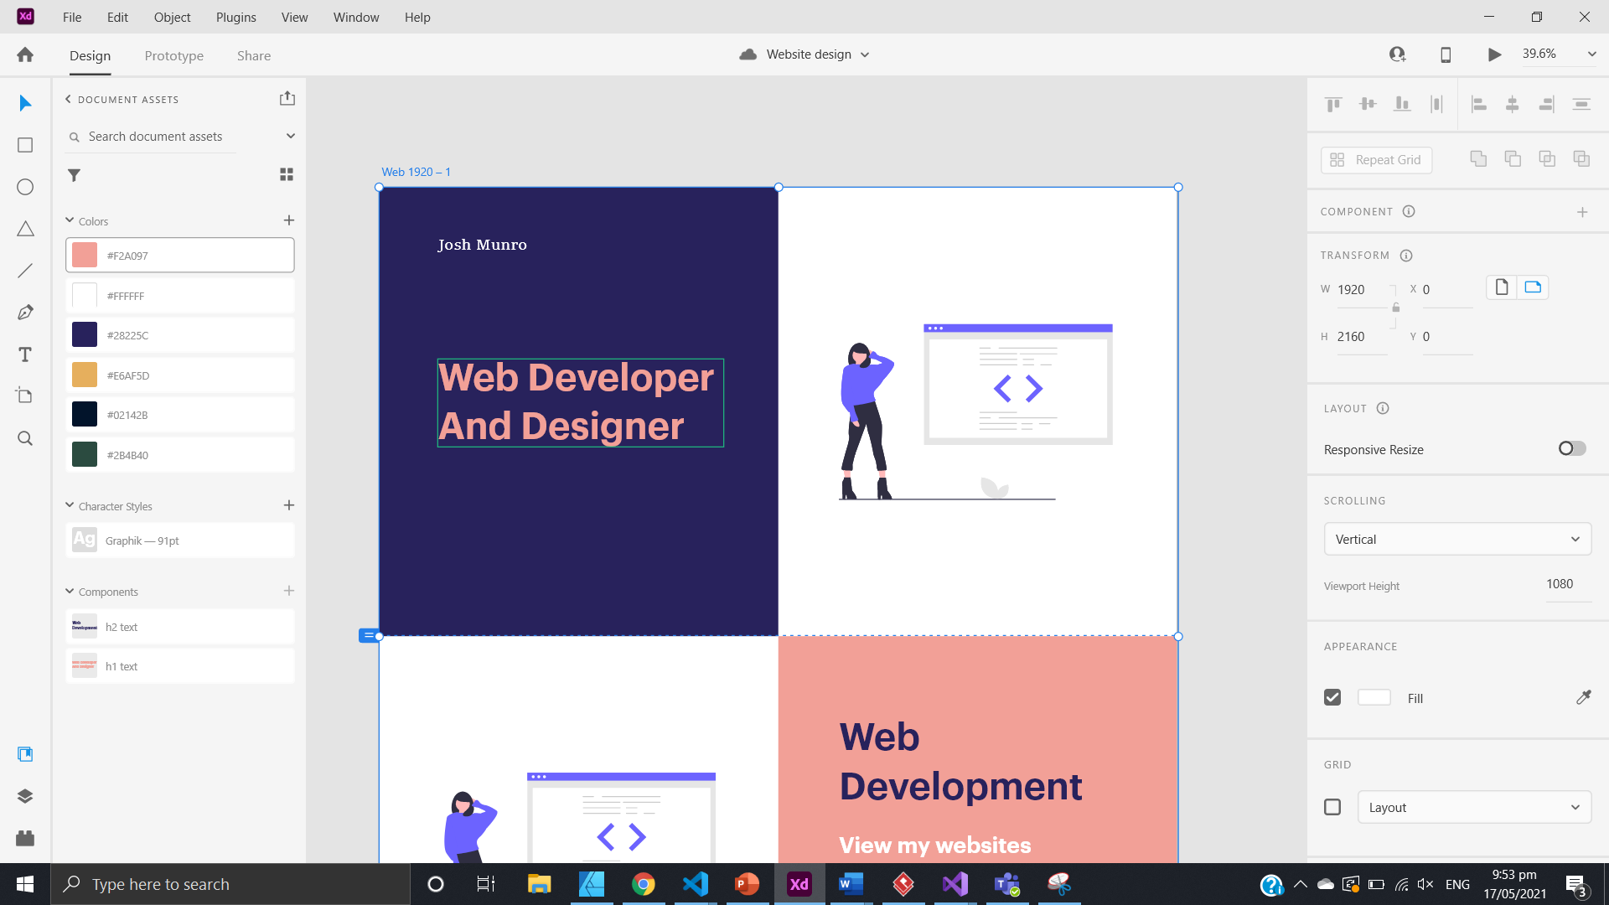
Evidence of XD

Slide 47
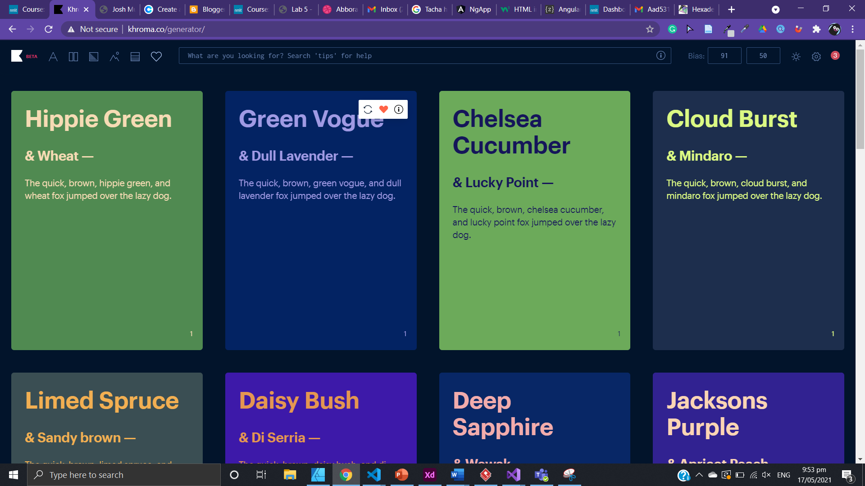
Evidence of Khorma

Slide 48
Using coolers to create user friendly colour palettes
Coolors was another great tool for

Slide 49
Struggles I had
The biggest challenge I faced was dealing and understanding how flex box worked in responsive design. There were many times when I didn’t understand why flexbox was acting a certain way particulary

Slide 50
Illustration page
I really liked the simplisitcy and theme carried from the home page to the illustration page. The illustration is simplistic and carrys the theme of crestivity growth, illustration. The next problem is to find a way to display the illustrations in a logical and user friendly way.

Slide 51
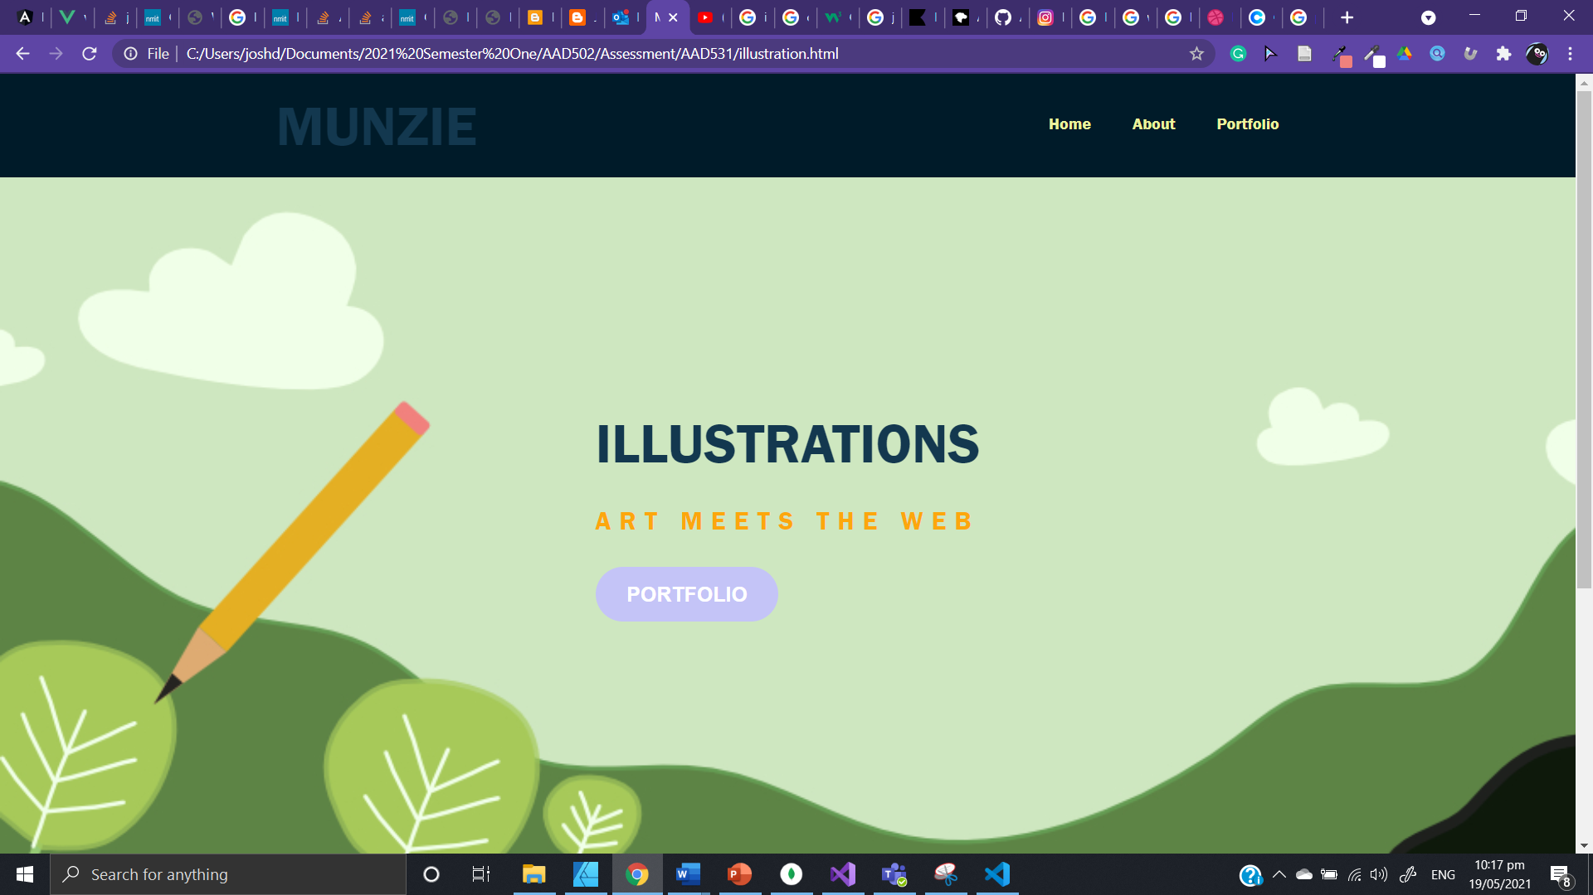

Slide 52
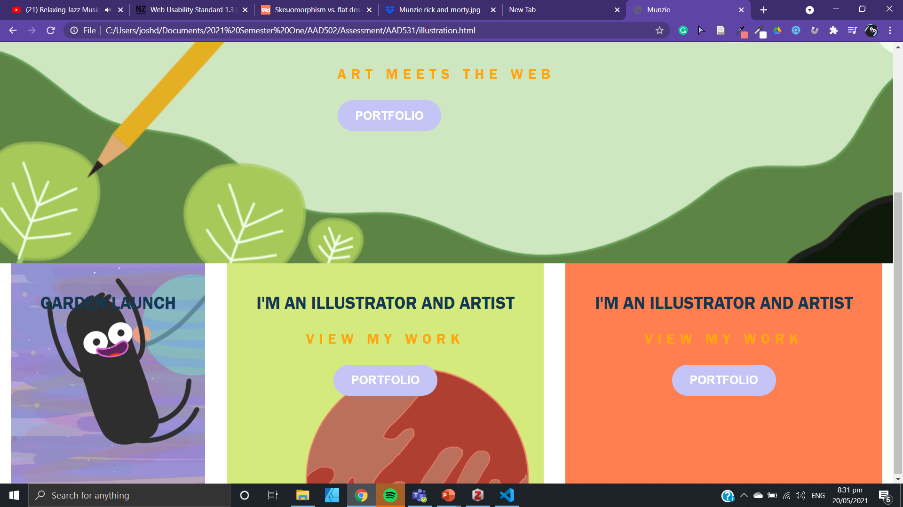

Slide 53
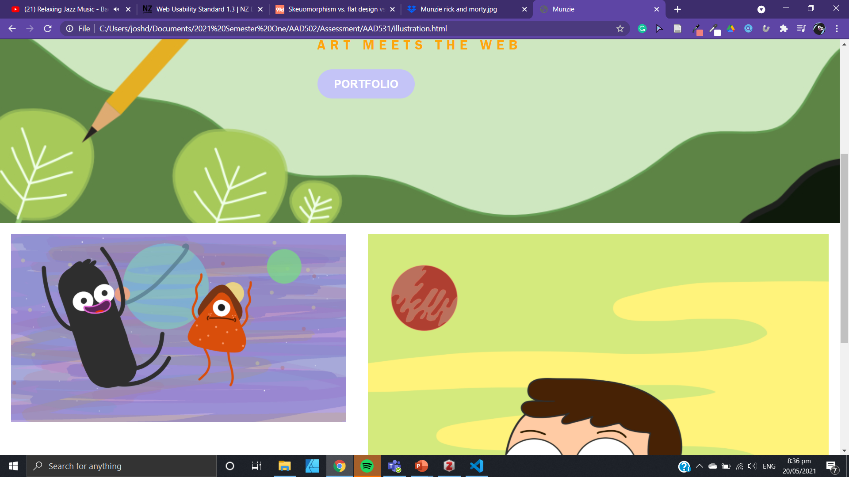

Slide 54
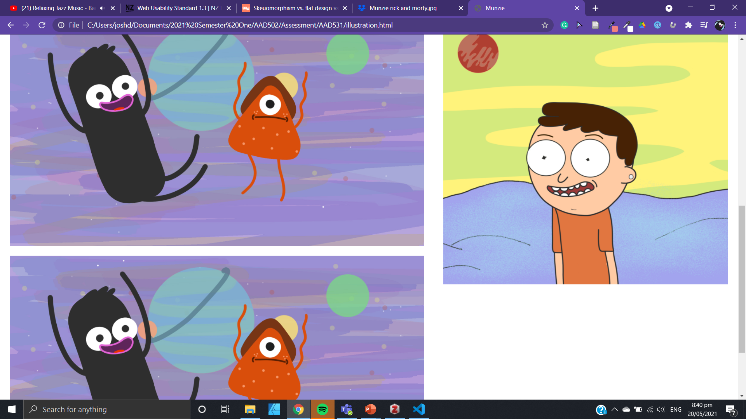

Slide 55
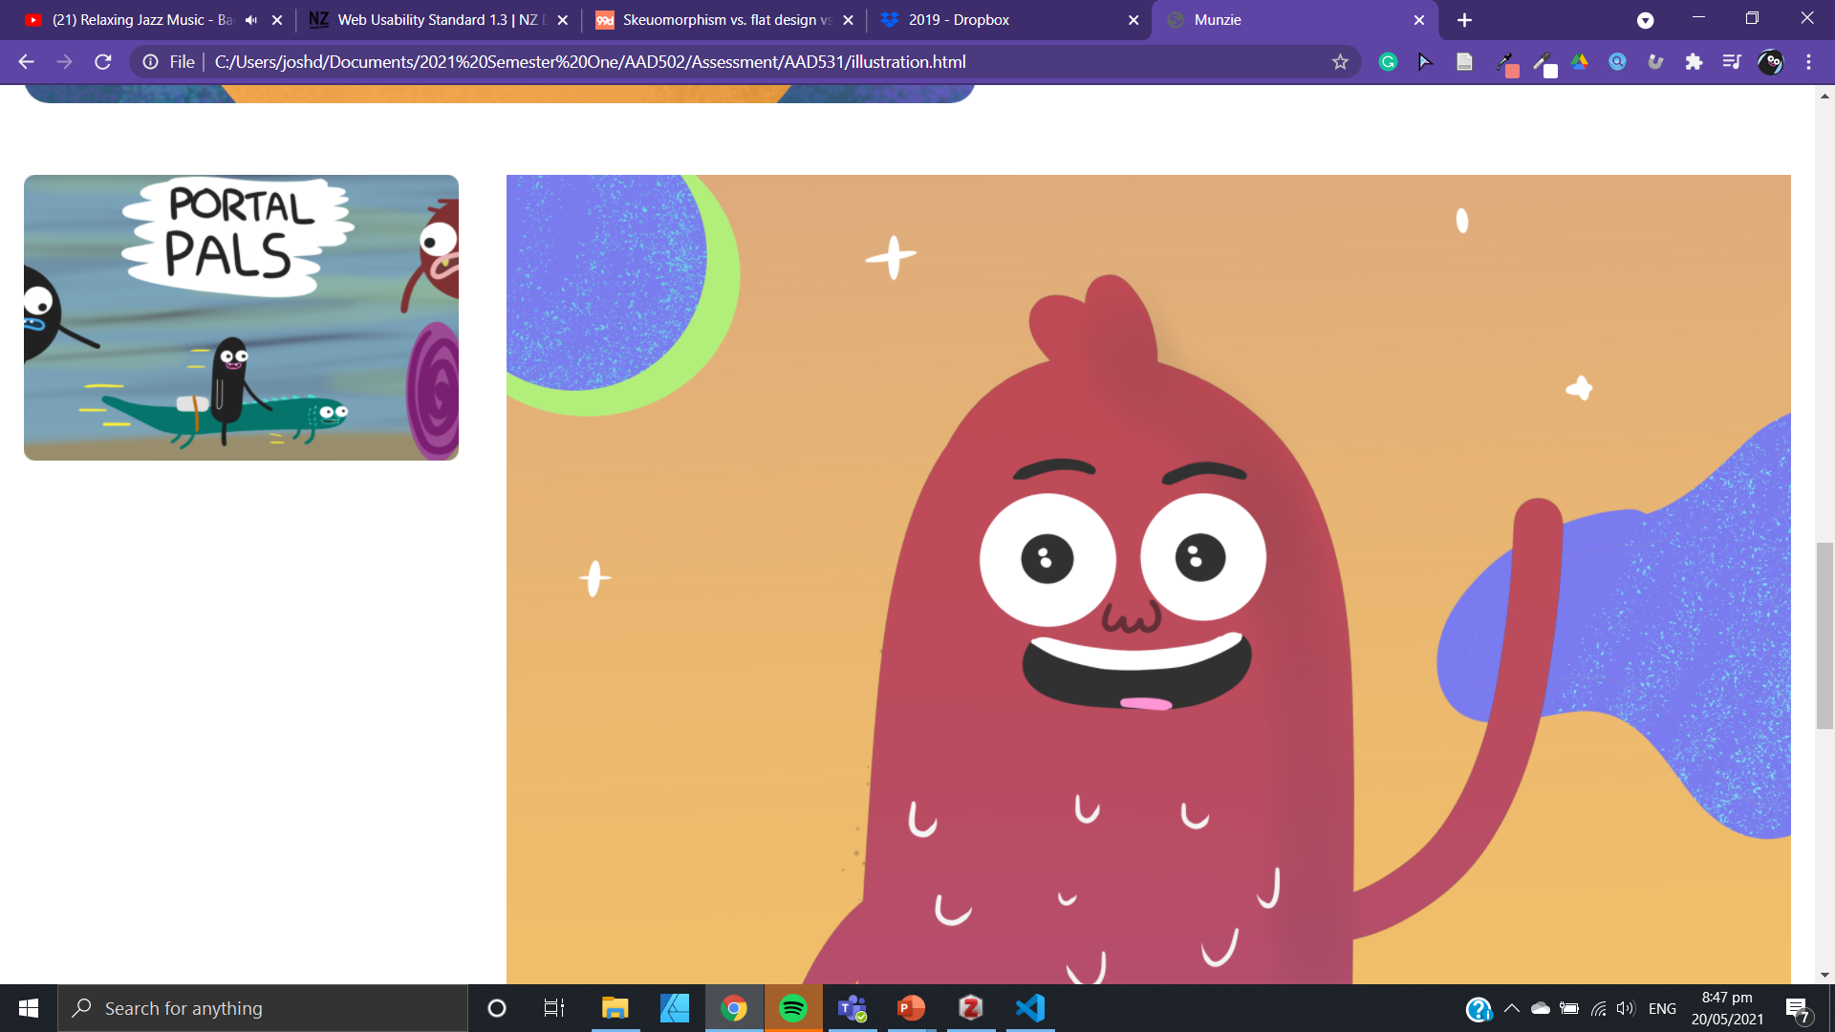

Slide 56
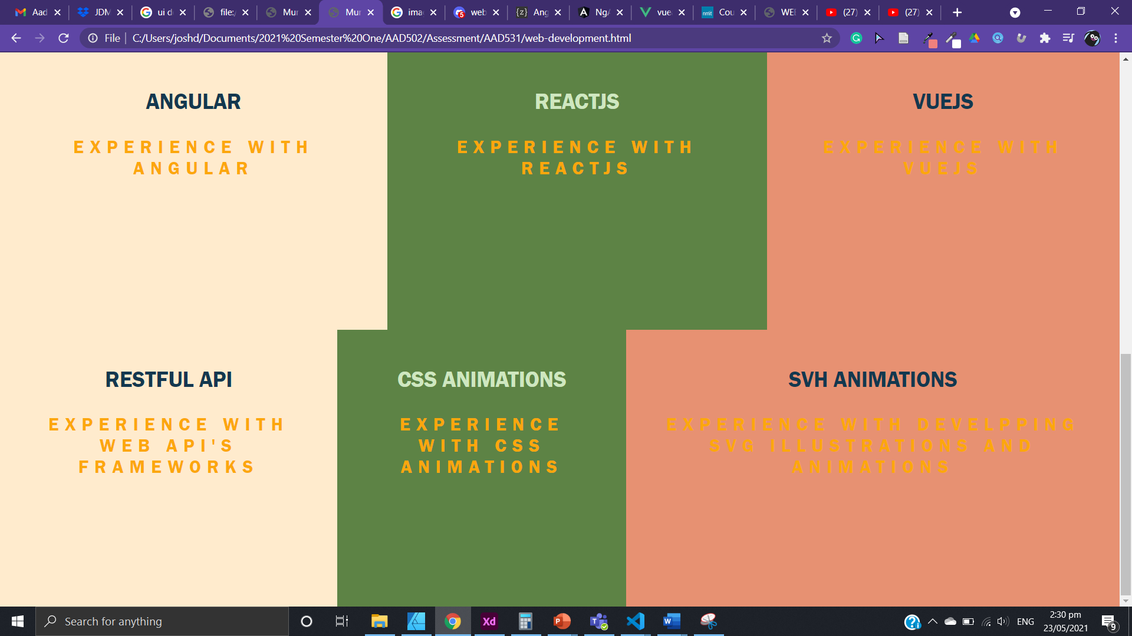
For the web development page, I have simple grid card containers to showcase the web development skills. Ideally I would like to show images of my work, but I don’t have enough time to do so, and I have a limited amount of work to showcase. I need to update the colours to make it easier to read

Slide 57
Final Evaluation
In final evaluation of my work, I was proud about the achievement and visualization of the website in the time that I had.
The theme of my project was Portfolio, but also growth and inspiration which came from the green colors and nature imagery/illustration design. I think this theme through my choice of colors, shapes, illustrations to achieve this effect.
I developed my ideas slowly over time through inspiration of my own thoughts and from a website called Dribble, where I found an illustration of nature and trees growing. I used wireframes, adobe XD and mockups to develop my ideas. Then I used HTML CSS and Flexbox to improve the design and explore other features could improve the design of the website.
My work changed a lot throughout the project. I had many different ideas, color palettes, illustrations and designs floating through my head. I had a hard time pinning to one idea. I initially chose a theme of blue and pink (two nicely contrasting colors) to be a major theme for my website. However, other time I noticed how there was no deciding factor to the theme and color choice which made me rethink the purpose of the website and how that can be represented through the use of design options (such as color and images/illustrations).
I didn’t have too many reference materials during my design process, I have a great interest in web design before the course, so I had an understanding of the sort of web portfolio I wanted to present.
The art movement of flat illustration design was a great factor in my art style and website design. Flat illustrations with pastel like colors was an inspiration for the illustration and color choices of the website.
My skill of refining what I want to achieve and evaluating and analyzing how I’m going to do that has been a challenge, but also a skill that I have picked up along the way.
It would be awesome to go into depth about CSS animations and have a greater understanding of flexbox. I believe that flexbox is a powerful and useful tool for web development and responsiveness.
I used adobe XD, affinity designer, Khorma, Coolors.io. These tools were very successful in the development and design phase of the website. All these tools played a vital part and were all very successful in doing so. However, I didn’t end up using the colors designed from Khorma but it gave me some inspiration and ideas to how I wanted my website to look and feel.

Slide 58
Evaluating my finished work
After evaluating my final work, I was proud of the final design in relation to the time frame I set myself for this project. I am glad that I spent time exploring different designs and themes for my website. In doing this I was able to know what I want and what I wanted through the use of trying different colours and layouts. In the end I am happy with the design and layout of the website. The website design has

Slide 59
Copyright
At its core copyright is designed to allow an owner of a property to have control to what others can do with it (Enabling Use & Re-Use | Make It Digital | DigitalNZ, n.d.)
Copyright is a nationwide legal protection with the ‘New Zealand Copyright act 1994’ (Enabling Use & Re-Use | Make It Digital | DigitalNZ, n.d.)
. The copyright protection allows the owner to control usually from a set period of time how to use, dipreute, copy, and sell their works (Enabling Use & Re-Use | Make It Digital | DigitalNZ, n.d.).
The copyright statements from New Zealand claims that website must follow the Web usability standard (NZ Government, n.d.).
Website must link to a copyright standard. Must be visible on the website home page (NZ Government, n.d.)
Must state that the copyright applies to the website, work on website is protected by copyright (NZ Government, n.d.)
If third party information is present, must link or reference to the third party source (NZ Government, n.d.)

Slide 60
Web design movements
Let's begin with Skeuomorphism, the word can be broken down to mean container tool, and shape (Skeuomorphism vs. Flat Design vs Material Design, 2016)
Thus, it means a shape inside a container. This relates to shapes and objects mimicking another real object/material shape (Skeuomorphism vs. Flat Design vs Material Design, 2016).
In old building structures, wooden cubes shapes were carved to a marble building. The illusion was designed to re-create wooden rafters shape (Skeuomorphism vs. Flat Design vs Material Design, 2016).
It is speculated that wooden structures were made before marble, so the builders wanted to bring a more familiar and relatable feeling to people entering the building shape (Skeuomorphism vs. Flat Design vs Material Design, 2016)
These examples can be seen in the early user interfaces of famous software products shape (Skeuomorphism vs. Flat Design vs Material Design, 2016)
Take the early apple iOS platform UI. The camera icon resemble a real looking camera lens with detailed texture to make the camera/icon seem realistic to a real camera, when in fact the camera on the iPhone was small and very different to a traditional camera. The email icon from early ios design, resembled an envelope, even though email through the internet doesn’t use real envelopes shape (Skeuomorphism vs. Flat Design vs Material Design, 2016).
Moving on, a new design movement called ‘flat design’ became popular in early 2010’s shape (Skeuomorphism vs. Flat Design vs Material Design, 2016).
The simplistic flat design brought minimalism and made full use of the space on the screen. For instance, the windows 8 UI has flat boxes and icons that makes the most of the space it has. Also, iOS moved to a flatter design, which brought simplicity and gave a cleaner look and feel for the user experience shape (Skeuomorphism vs. Flat Design vs Material Design, 2016)
Each element was designed to have one saturation, hue, and no shadow.
From flat design came material design. Material design is an idea started from Google shape (Skeuomorphism vs. Flat Design vs Material Design, 2016)
There are a few rules that designers must follow to achieve this design movement. No element must overlap, all elements must be opaque, and no element can fold or bend shape (Skeuomorphism vs. Flat Design vs Material Design, 2016)
There are also strict rules for how interaction between the user and UI takes place. The reason for these design ideas is to give users the most intuitive and user-friendly experience possible shape (Skeuomorphism vs. Flat Design vs Material Design, 2016).

Slide 61
References
Enabling Use & Re-use | Make it Digital | DigitalNZ. (n.d.). Retrieved May 20, 2021, from https://digitalnz.org/make-it-digital/enabling-use-re-use
NZ Government. (n.d.). Copyright statements for websites. New Zealand Digital Government. Retrieved May 20, 2021, from https://www.digital.govt.nz/standards-and-guidance/design-and-ux/usability/copyright-statements-for-websites/
Skeuomorphism vs. Flat Design vs Material Design. (2016, October 25). 99designs. https://99designs.com/blog/trends/skeuomorphism-flat-design-material-design/

